Slide 1


Library Helper
CS 151 – Fall 19: Final Project
Group#: 15
Duy Le
Tuong Chu
Duy Tran
Advisor: Professor Nada Attar

Slide 2

Configuration
Install Java 8 and above: https://www.oracle.com/technetwork/java/javase/downloads/index-jsp-138363.html
Download and unzip
In Windows: open file Library Helper.exe at
~/CS151-Group15-LibraryHelper/Library Helper Software/Library Helper.exe
In Mac OS: open file LibraryHelper.jar at
~/CS151-Group15-LibraryHelper/LibraryHelper/dist/LibraryHelper.jar

Slide 3
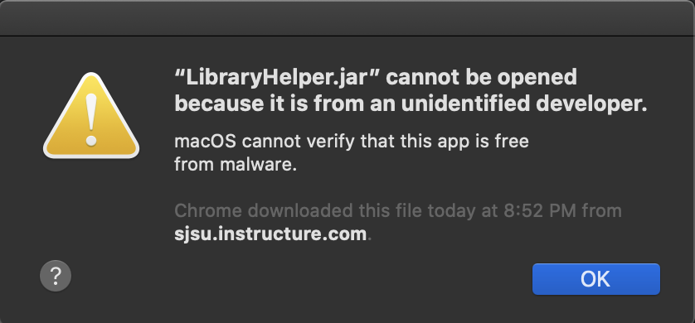
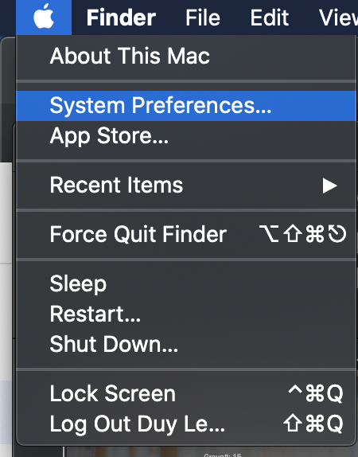
Configuration
On Mac Os, If this message pop up, it is because the app is not registered with Apple.
Please go to
System Preferences> Security&Privacy> General

Slide 4
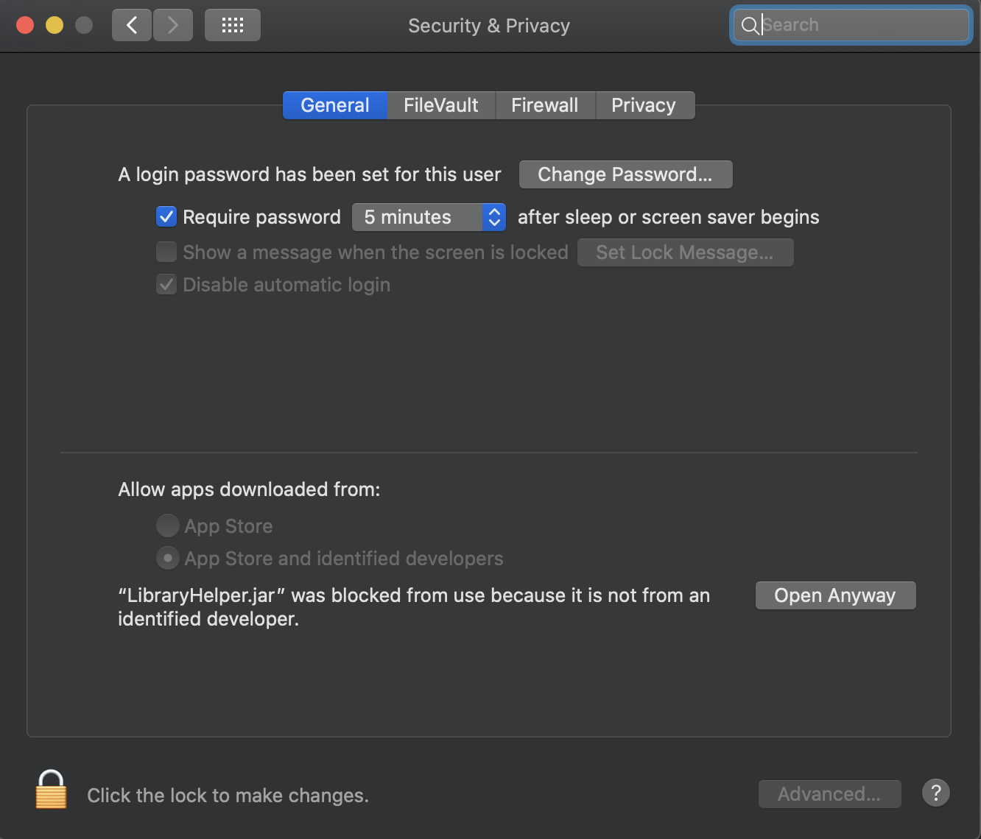
Configuration
Then click on the Yellow Lock at the bottom to give authorization
Then click on Open Anyway to run the app.

Slide 5
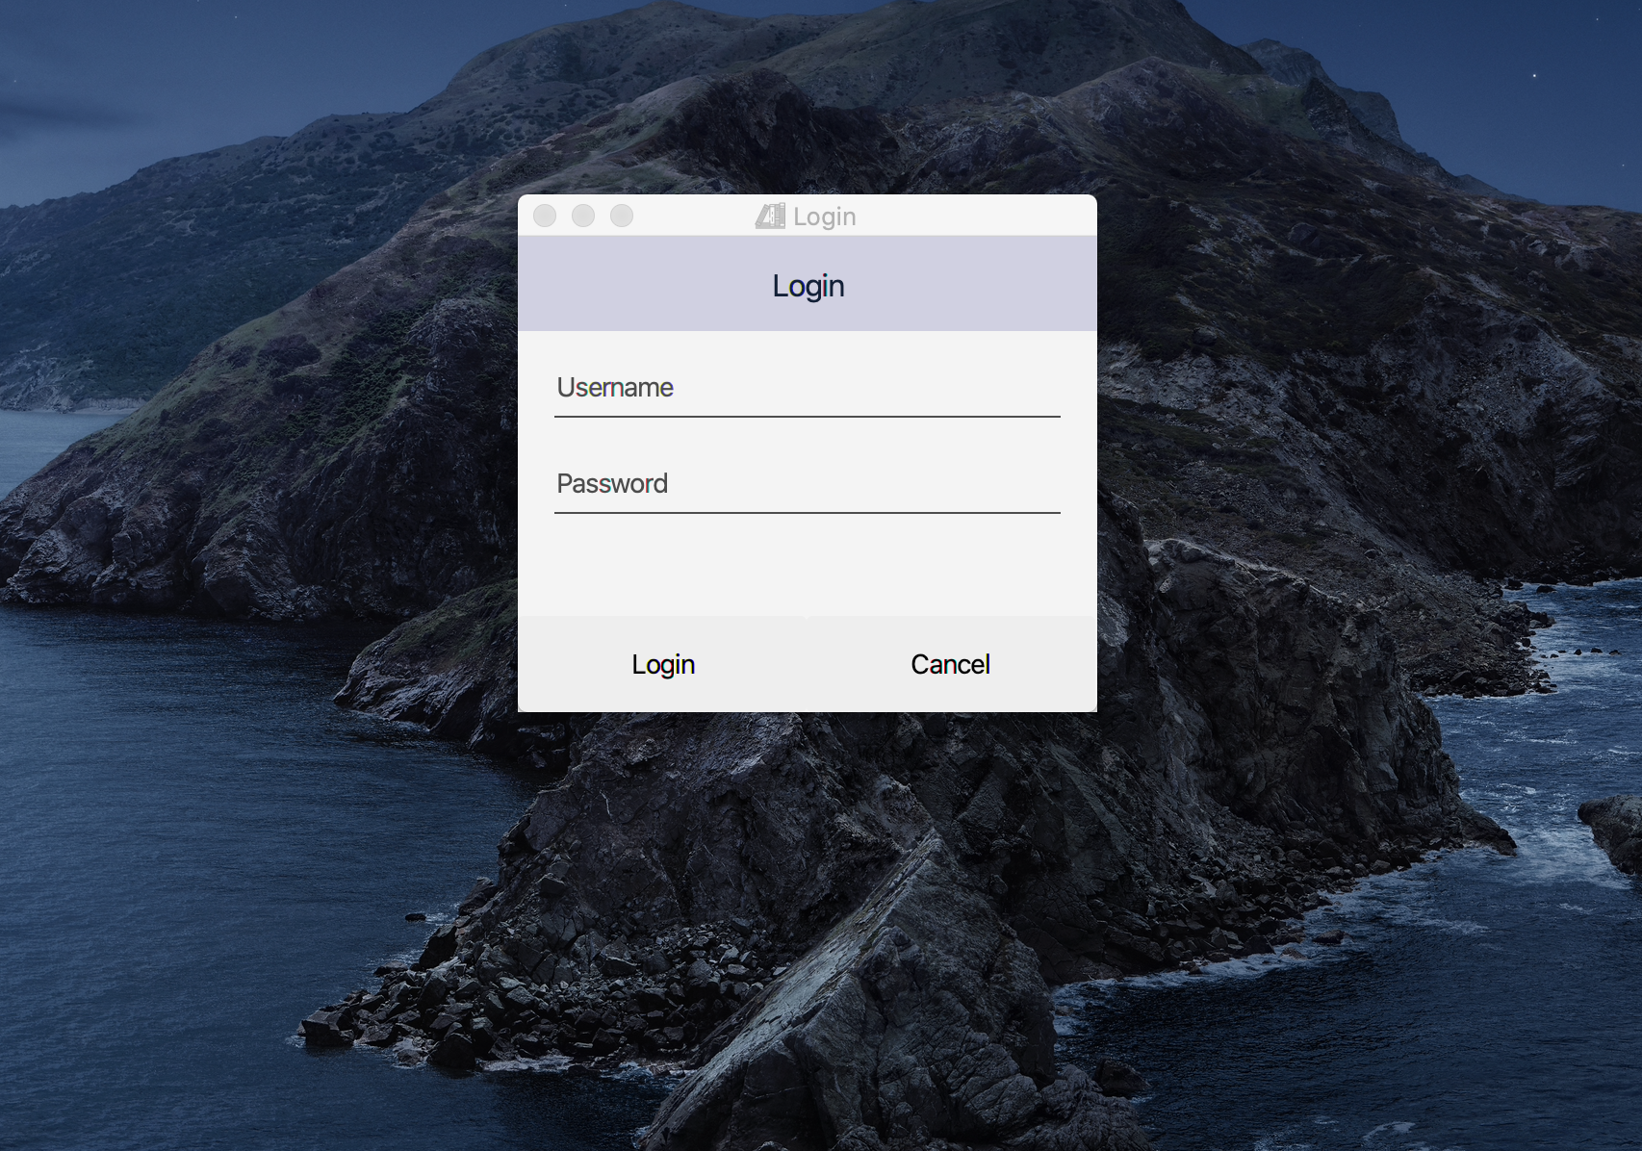
1. Login page:

Slide 6
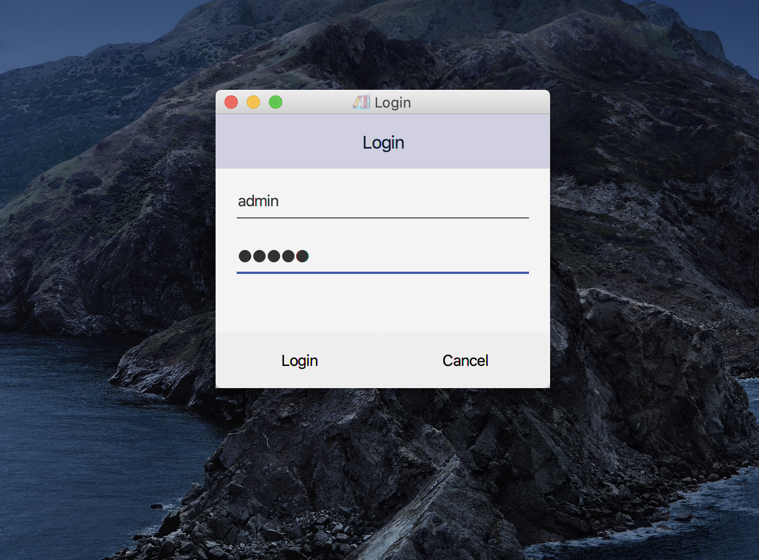
1. Login page:
Fill out
Username: admin
Password: admin
Click on Login button to get to main page

Slide 7
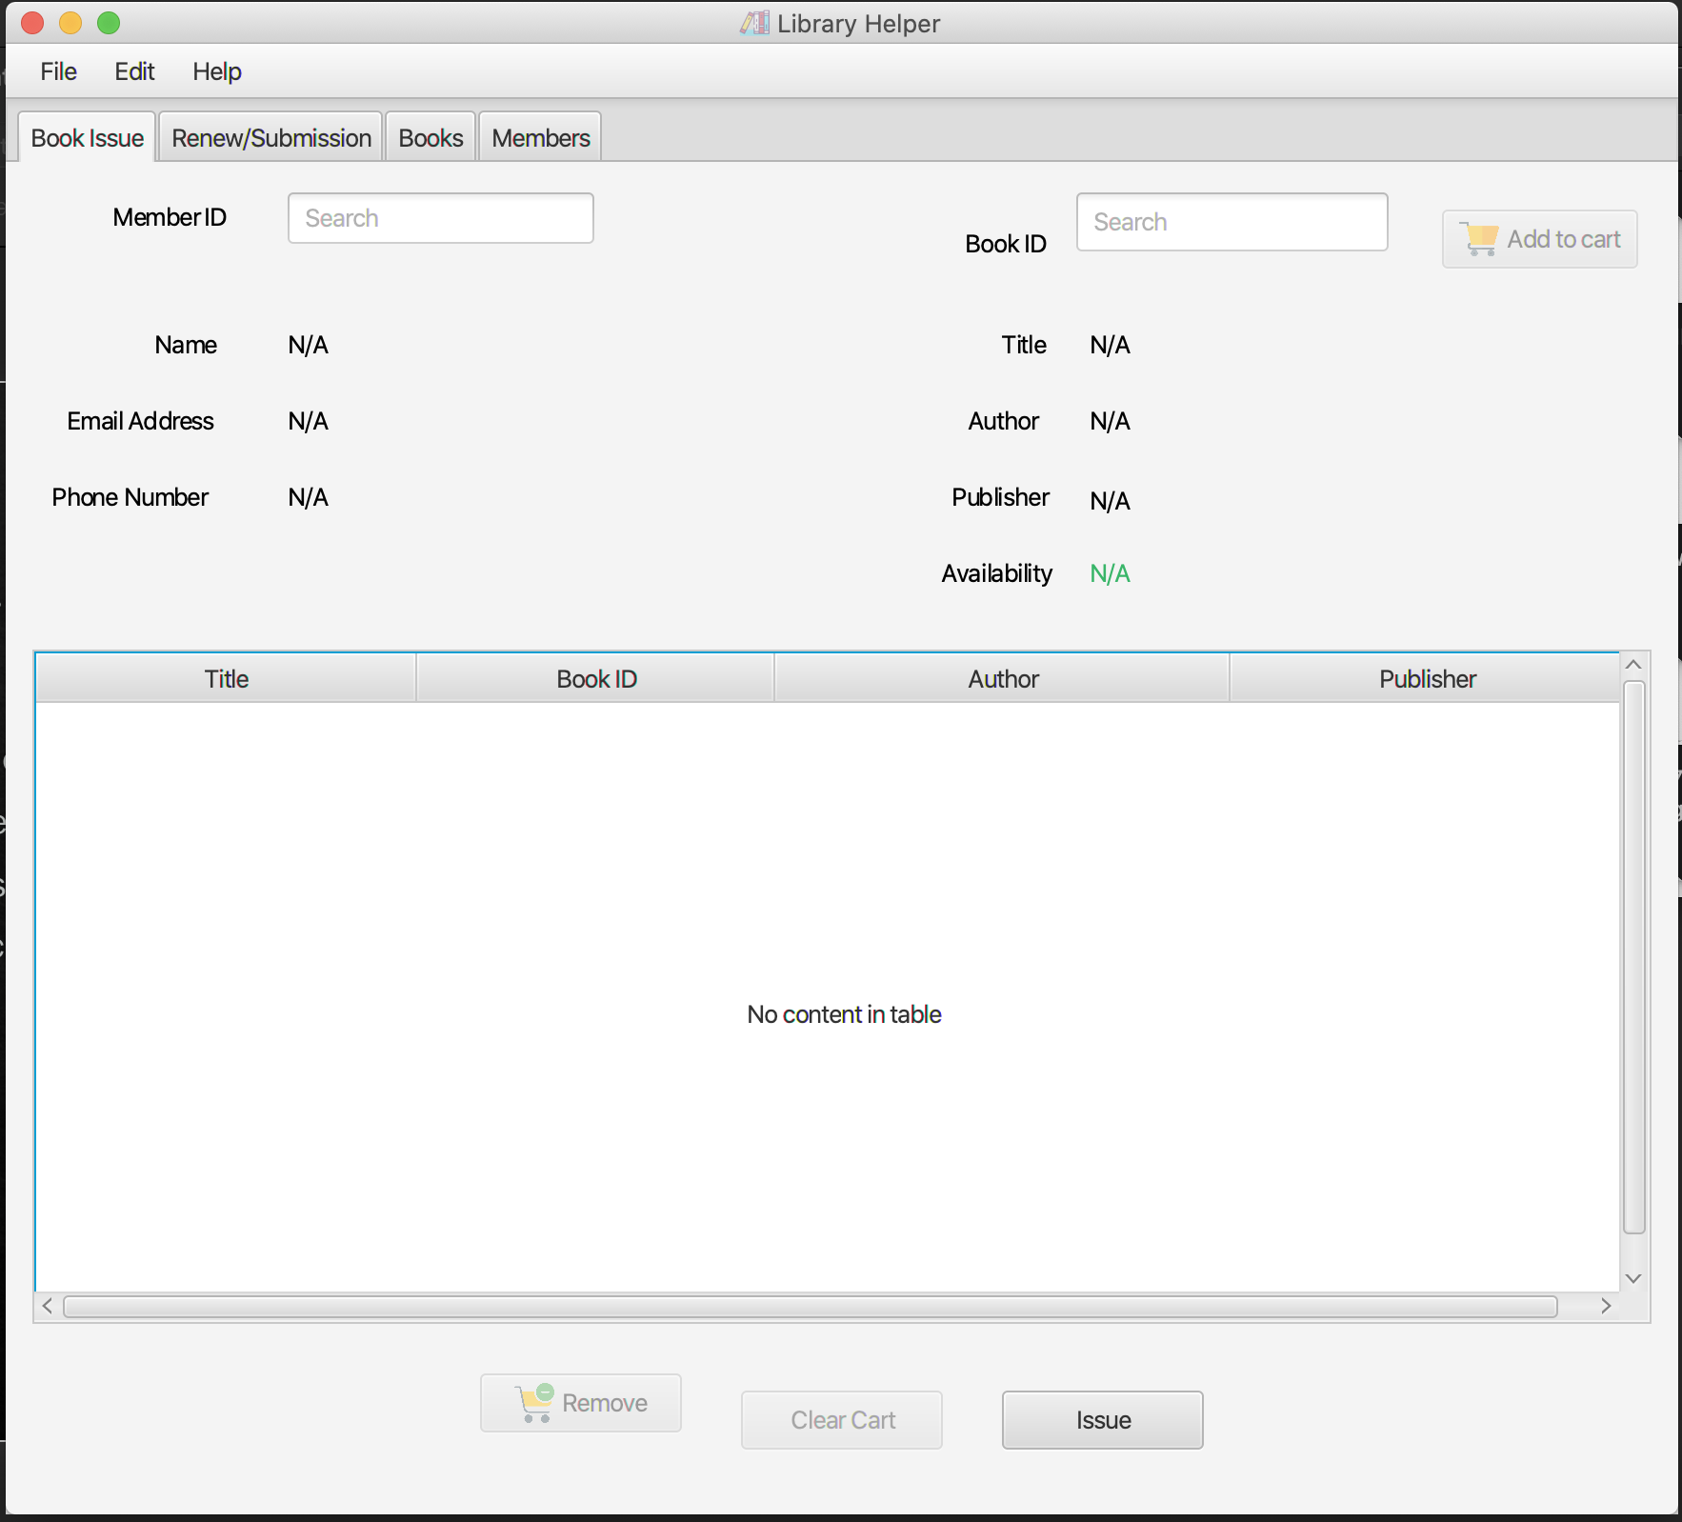
2. Main page:
Main features:
View current Books
View current Members
Add new books
Add new members
Edit books/members
Delete books/members
Search books/members
Issue books
Submit books
Renew books
File: Settings

Slide 8
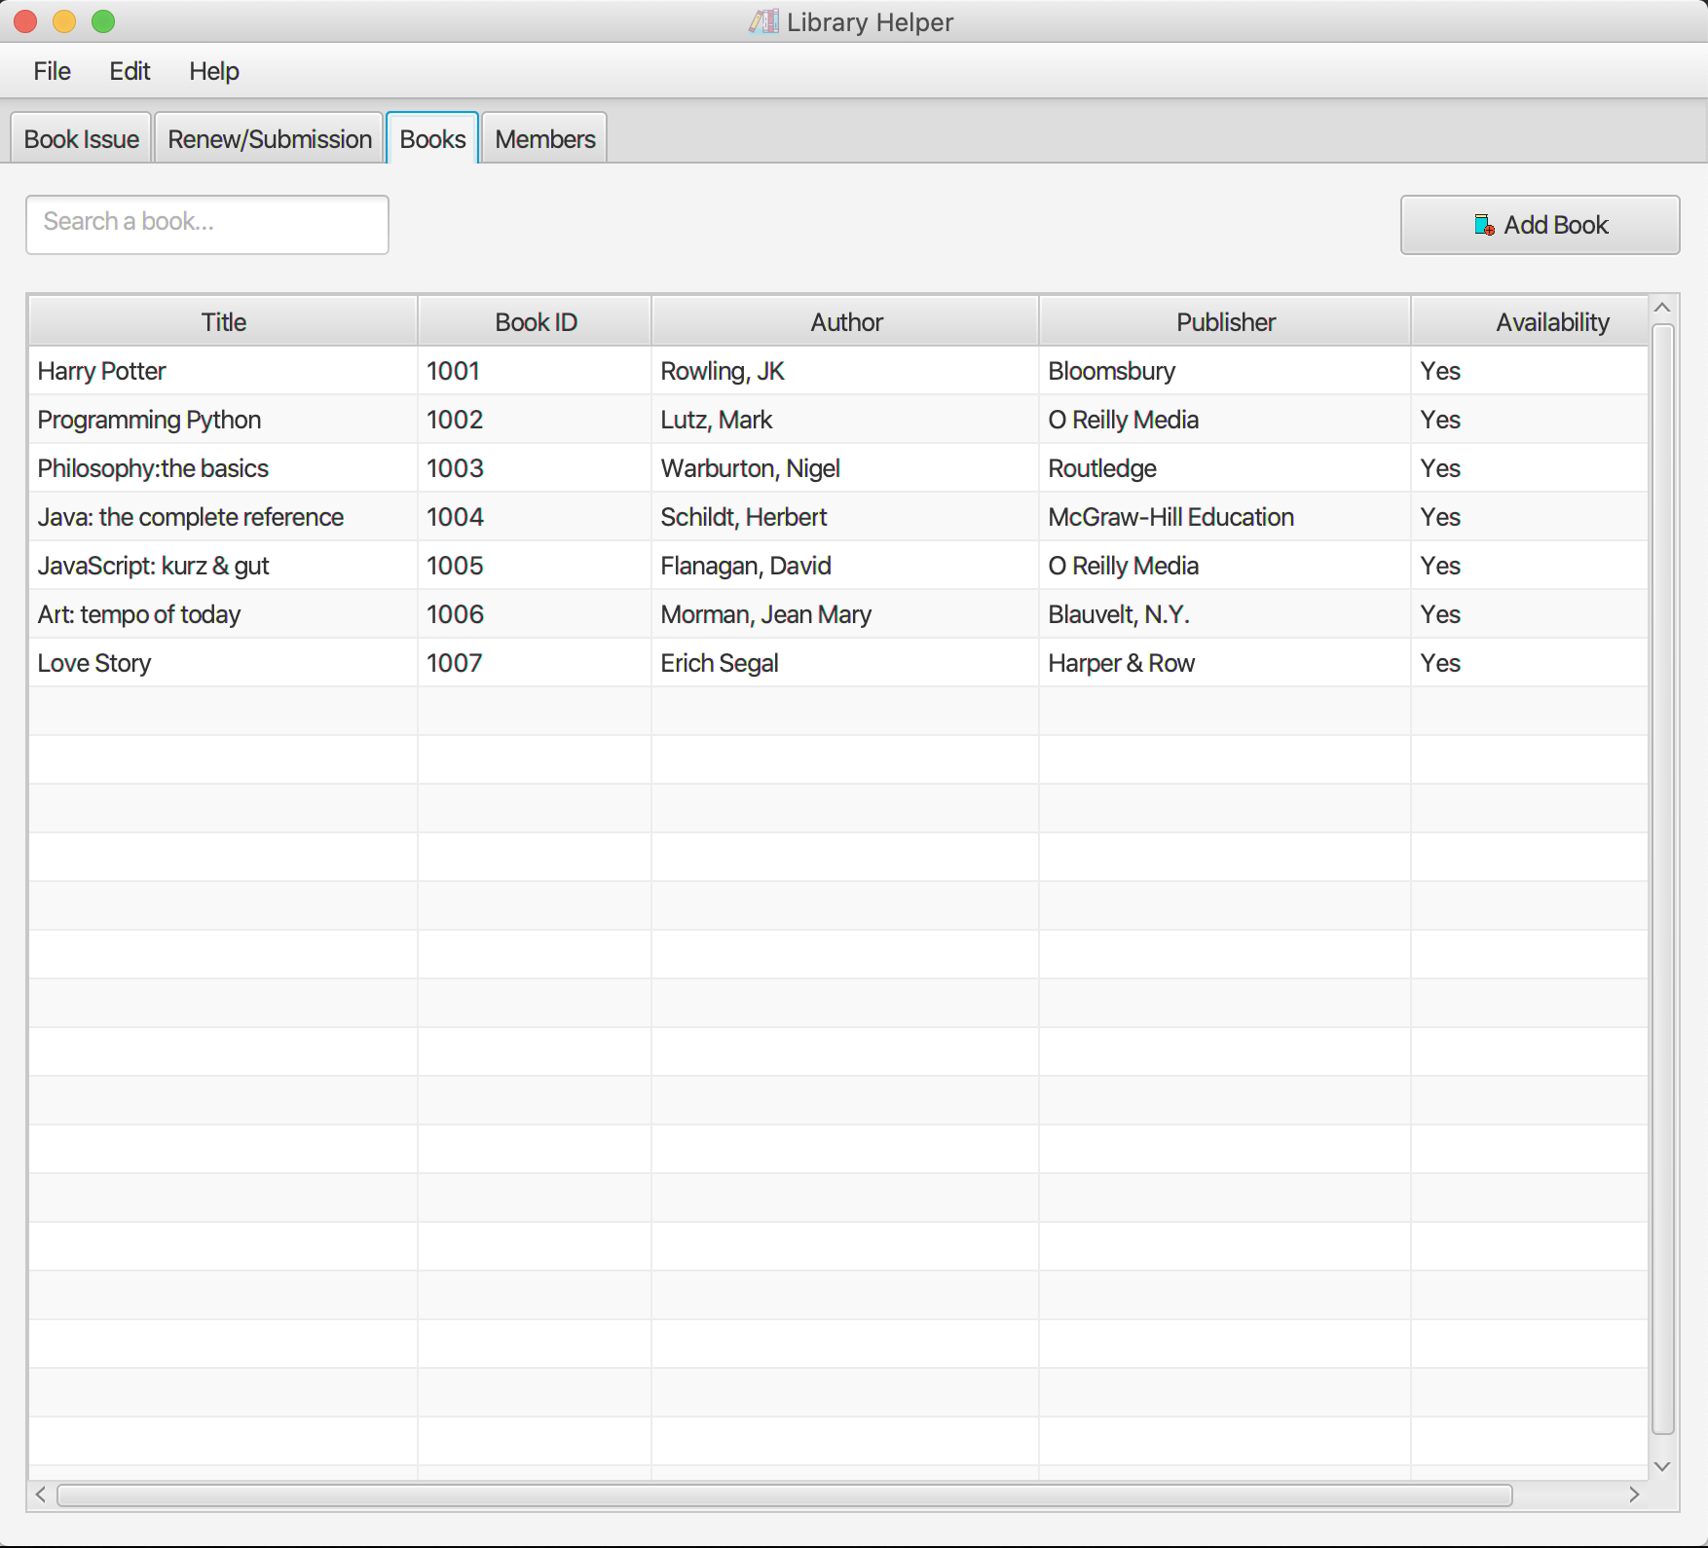
3. View current books
Click on the “Books” tab on the Menu bar
Some book data have been initiated into the database

Slide 9
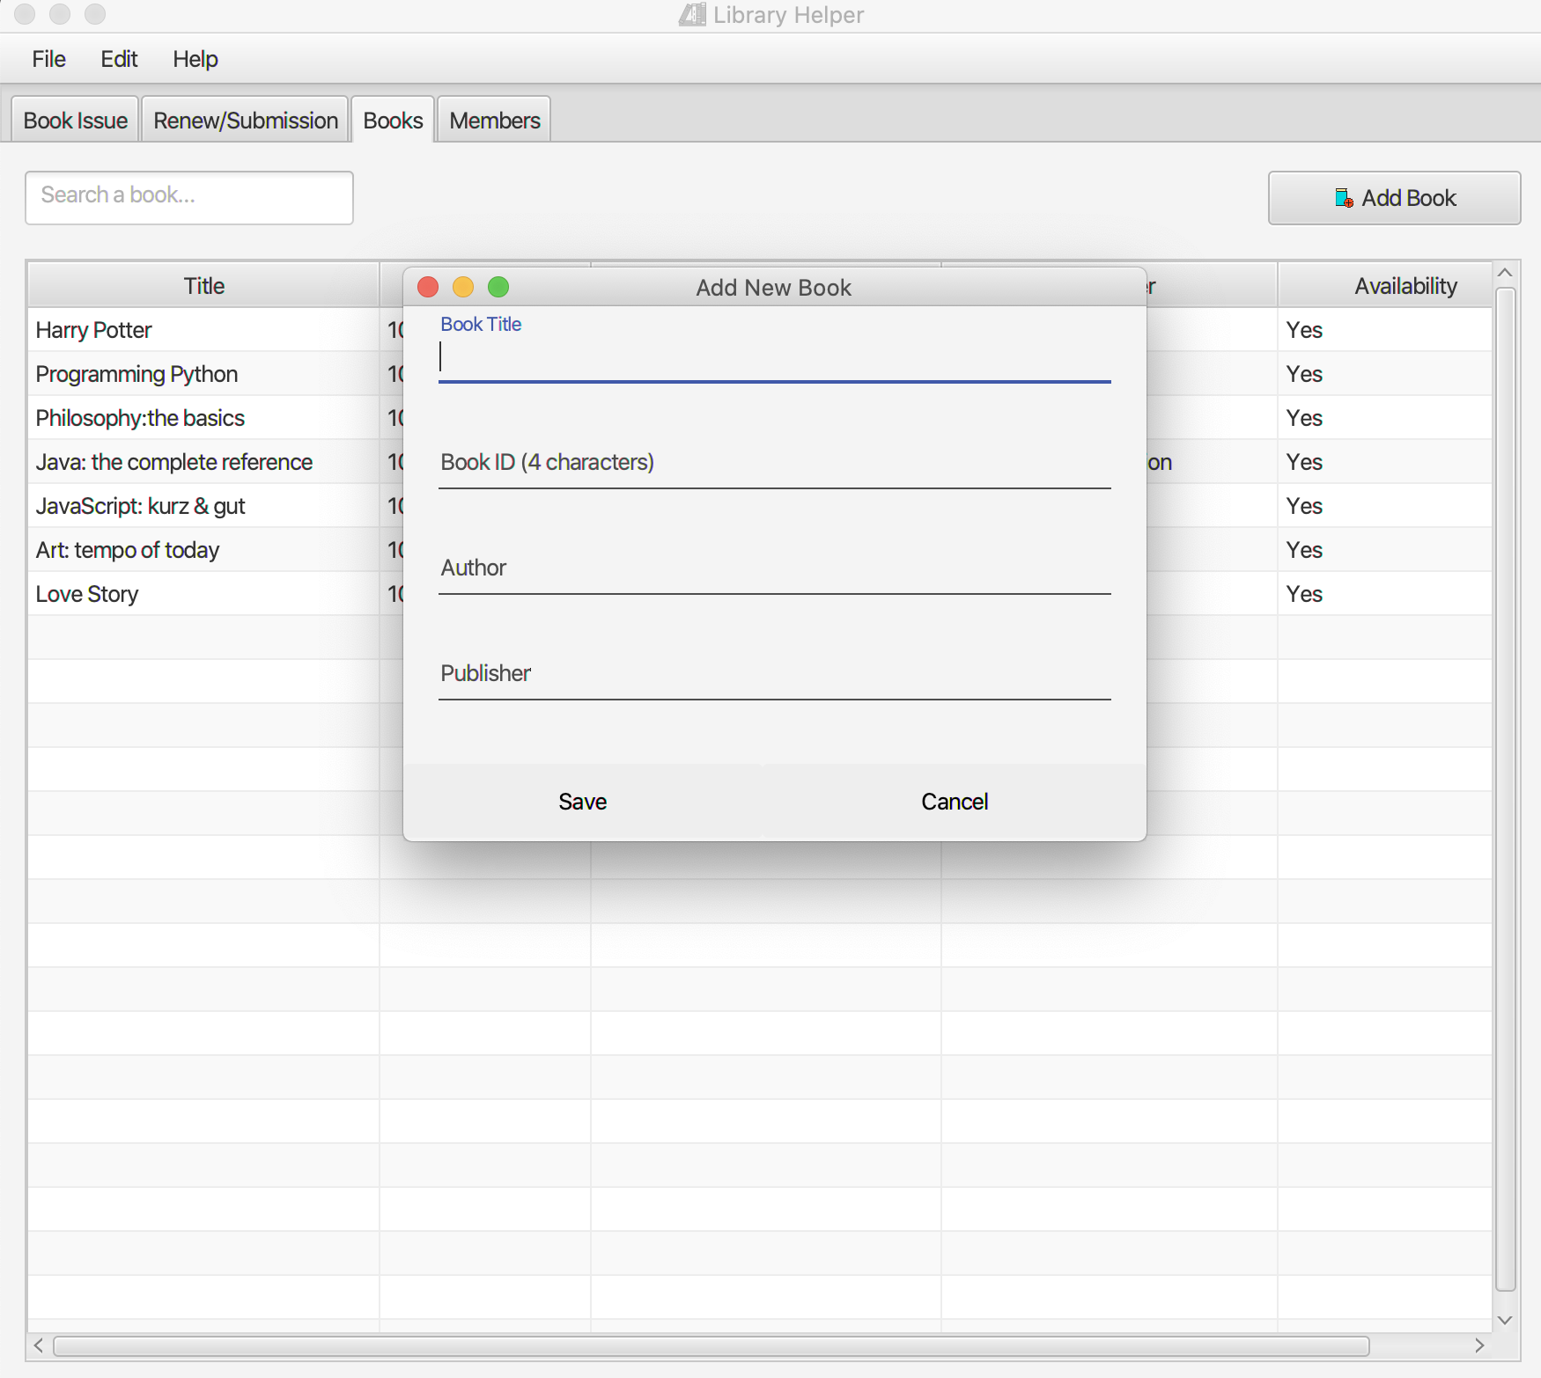
3. Add new books
Click on the “Add book” button on the right and fill out the form with the new book’s information

Slide 10
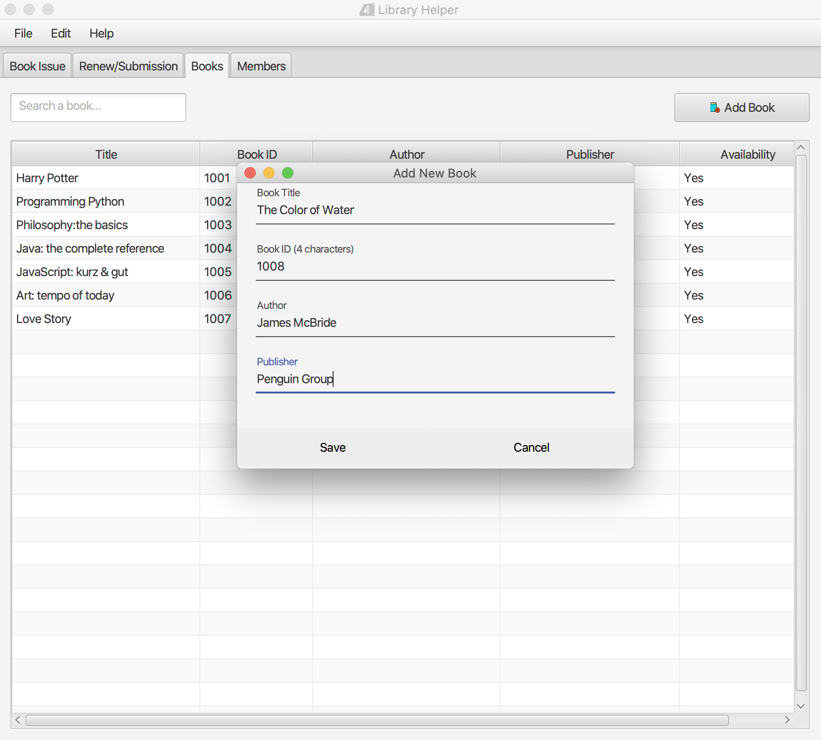
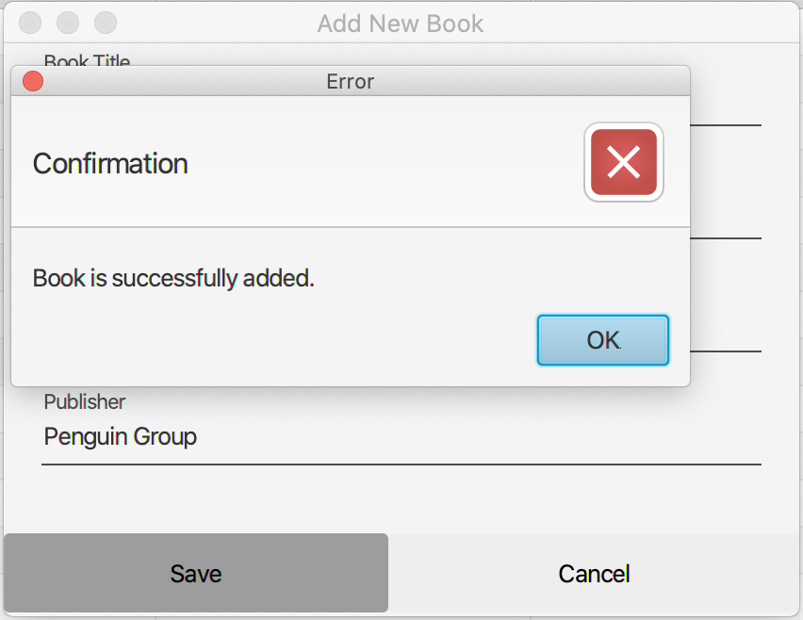
3. Add new books
Click on the “Save” button to add the new book to the database

Slide 11
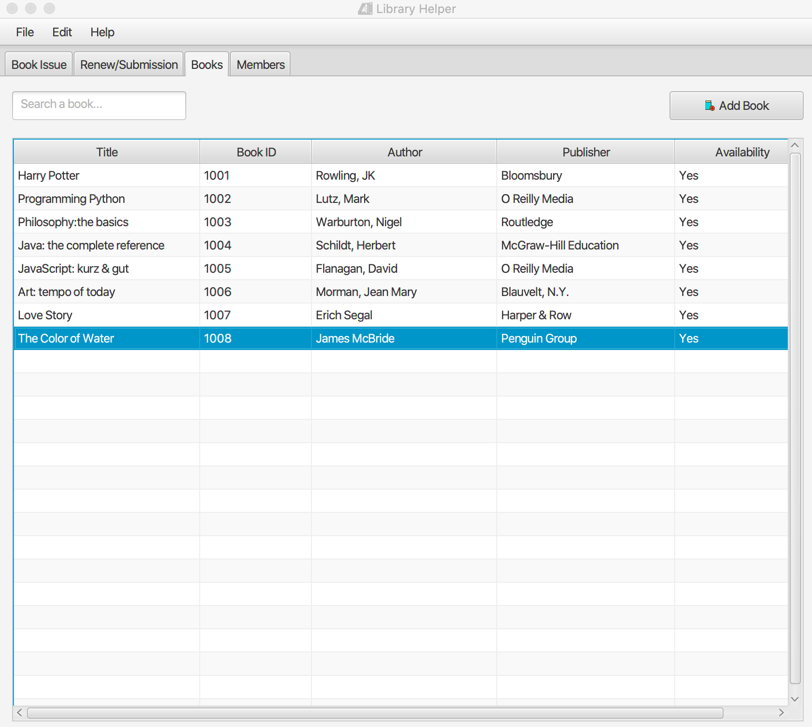
3. Add new books
The new book “The Color of Water” was added and displayed on the book list.

Slide 12
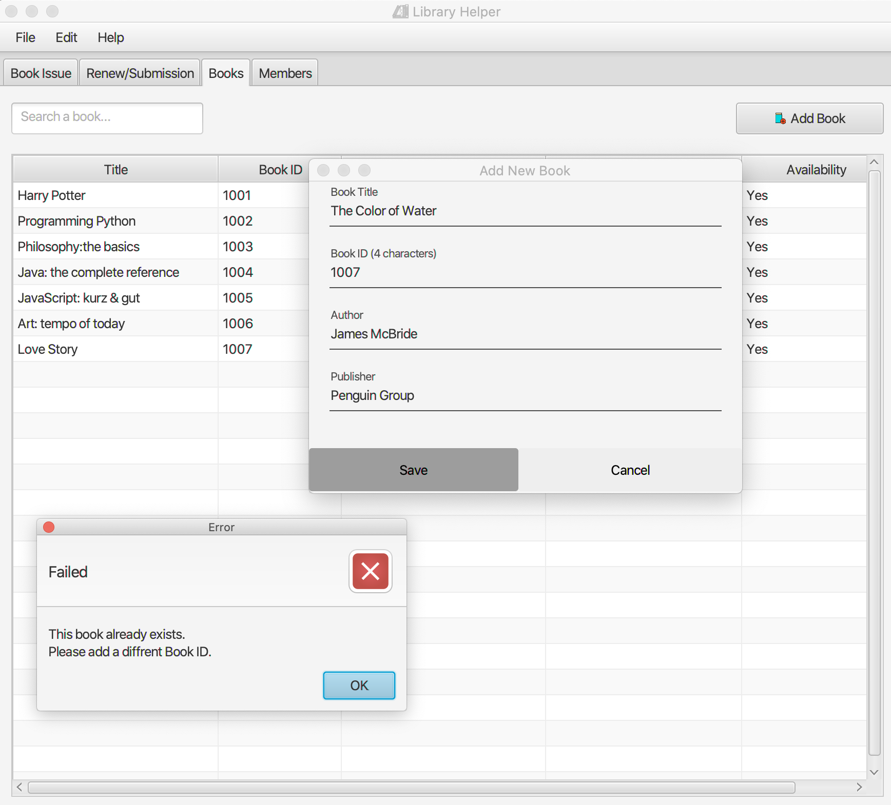
3. Add new books
Book ID is a unique key, so if users type in an existing book ID, an error message will be displayed.

Slide 13
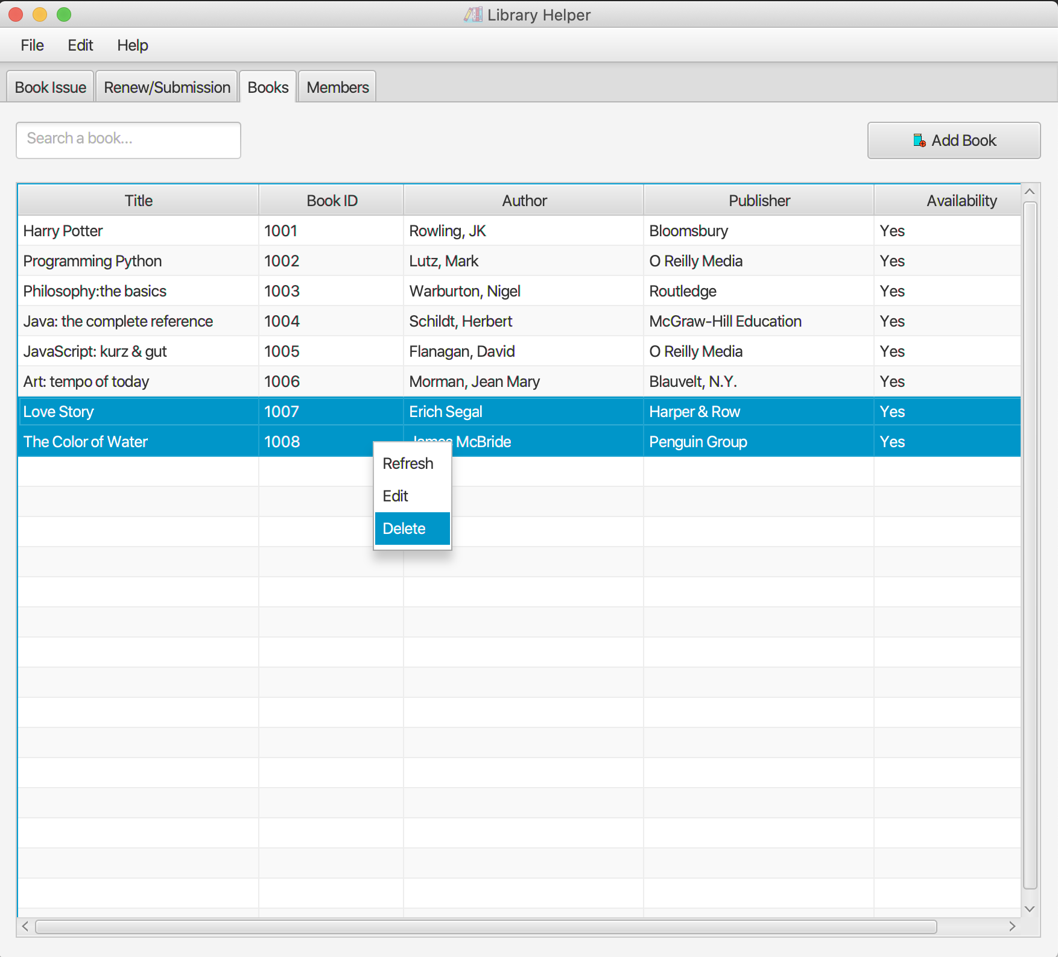
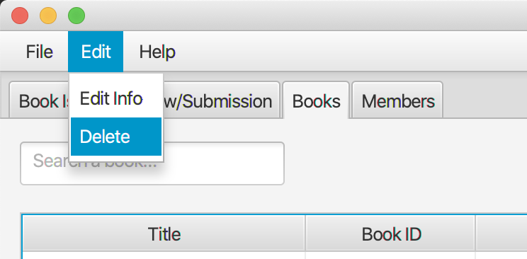
4. Delete books
Click on one or more books to select them.
Then right click and choose “Delete”
Or click on ”Edit” tab on the Menu bar and choose “Delete”

Slide 14
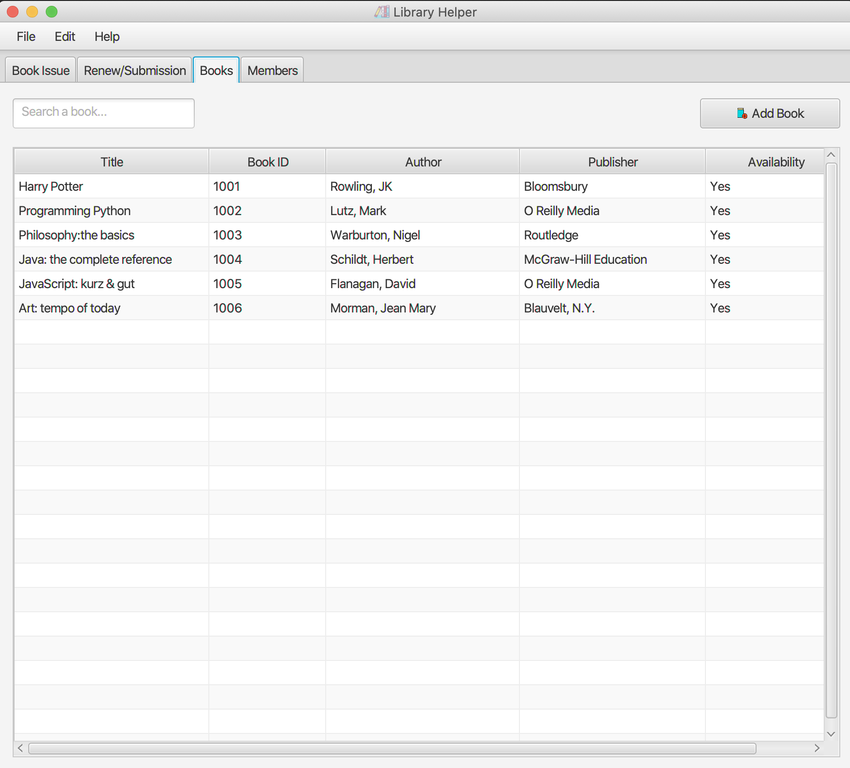
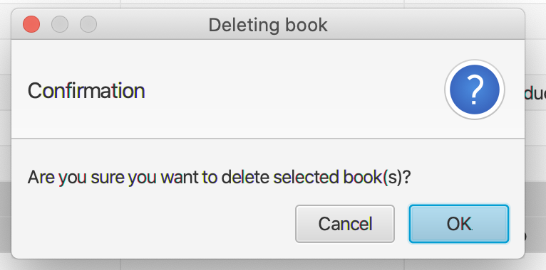
4. Delete books
Click on OK button to delete books from the database
Books titled “Love Story” and “The Color of Water” have been removed from the list

Slide 15
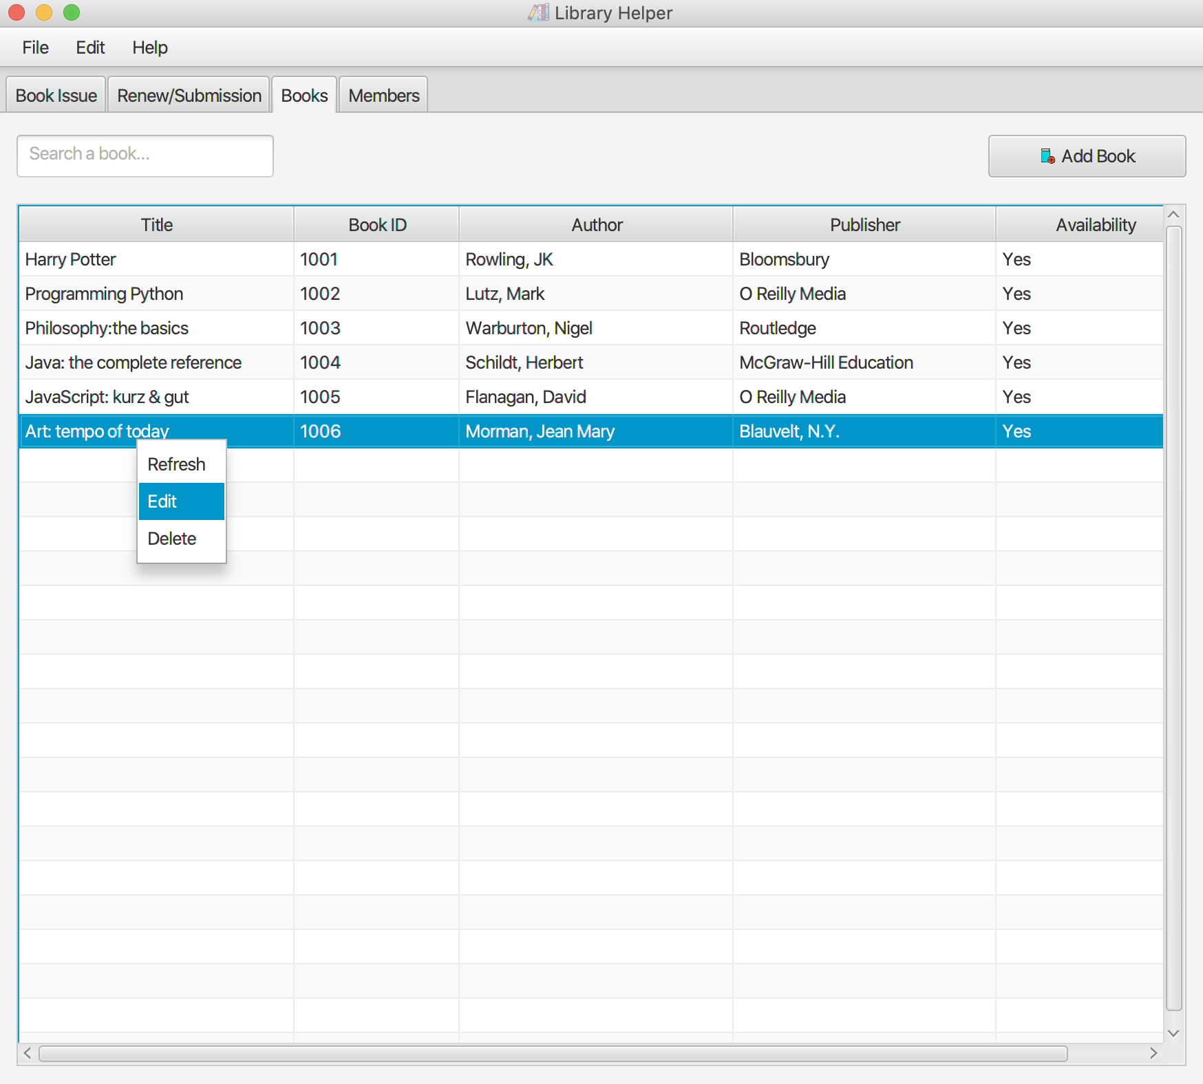
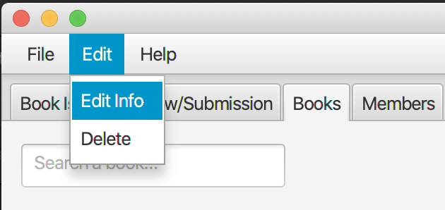
5. Edit books
Click on a book to select
Right click and choose Edit to edit its information
Or click on ”Edit” tab on the Menu bar and choose “Edit Info”
Book ID cannot be edited

Slide 16
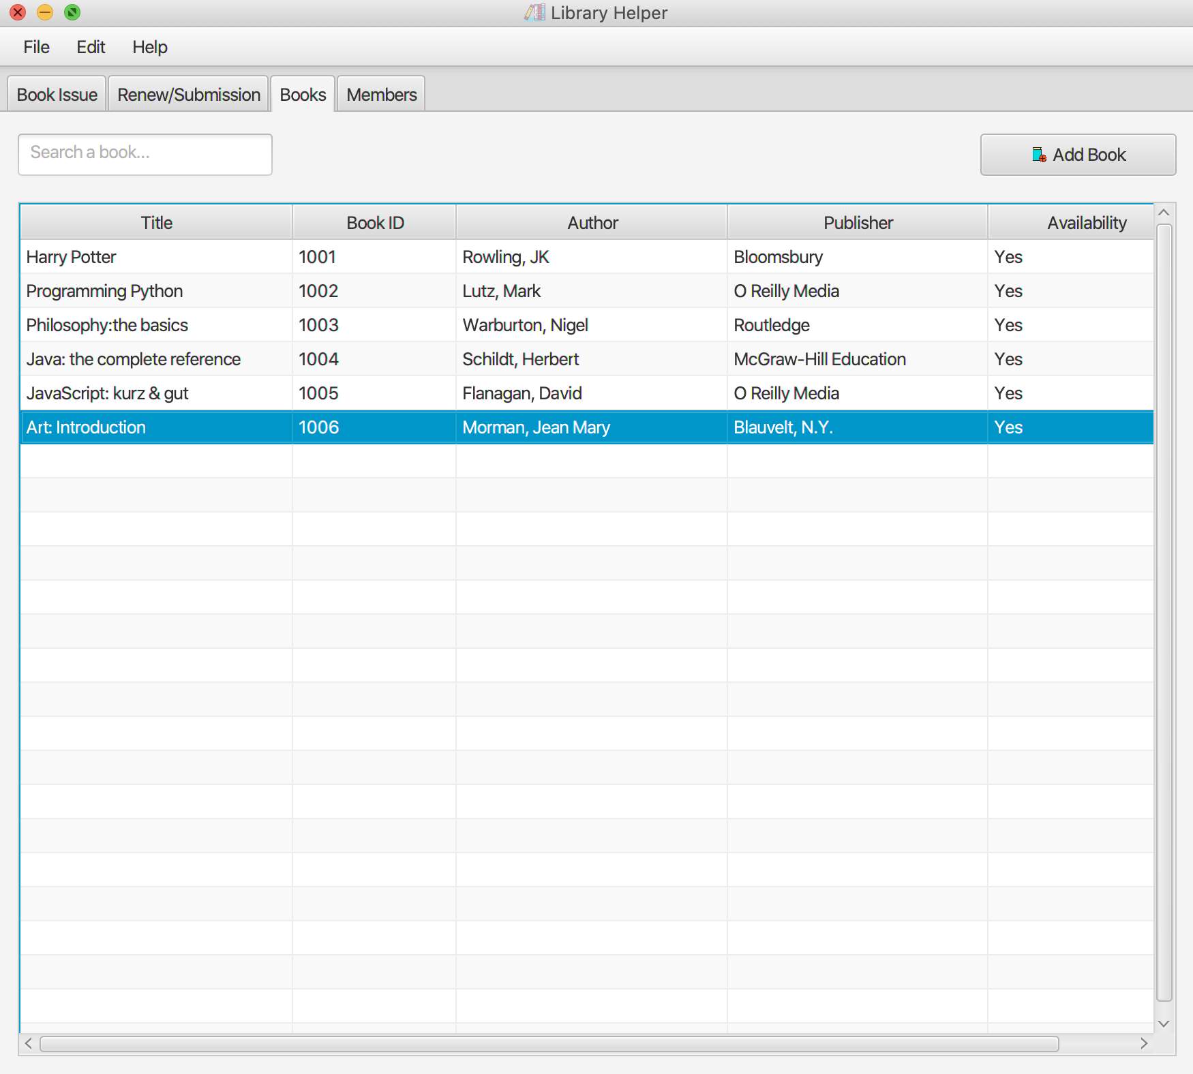
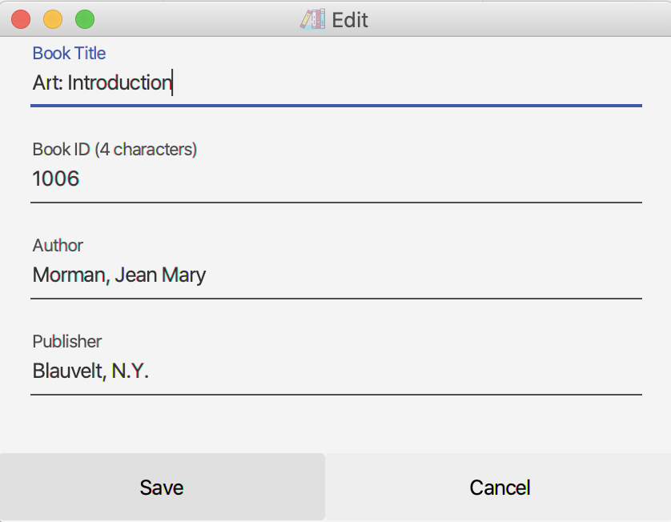
5. Edit books
Edit the book’s title and click on the Save button to submit
New book’s title will be displayed on the book list.

Slide 17
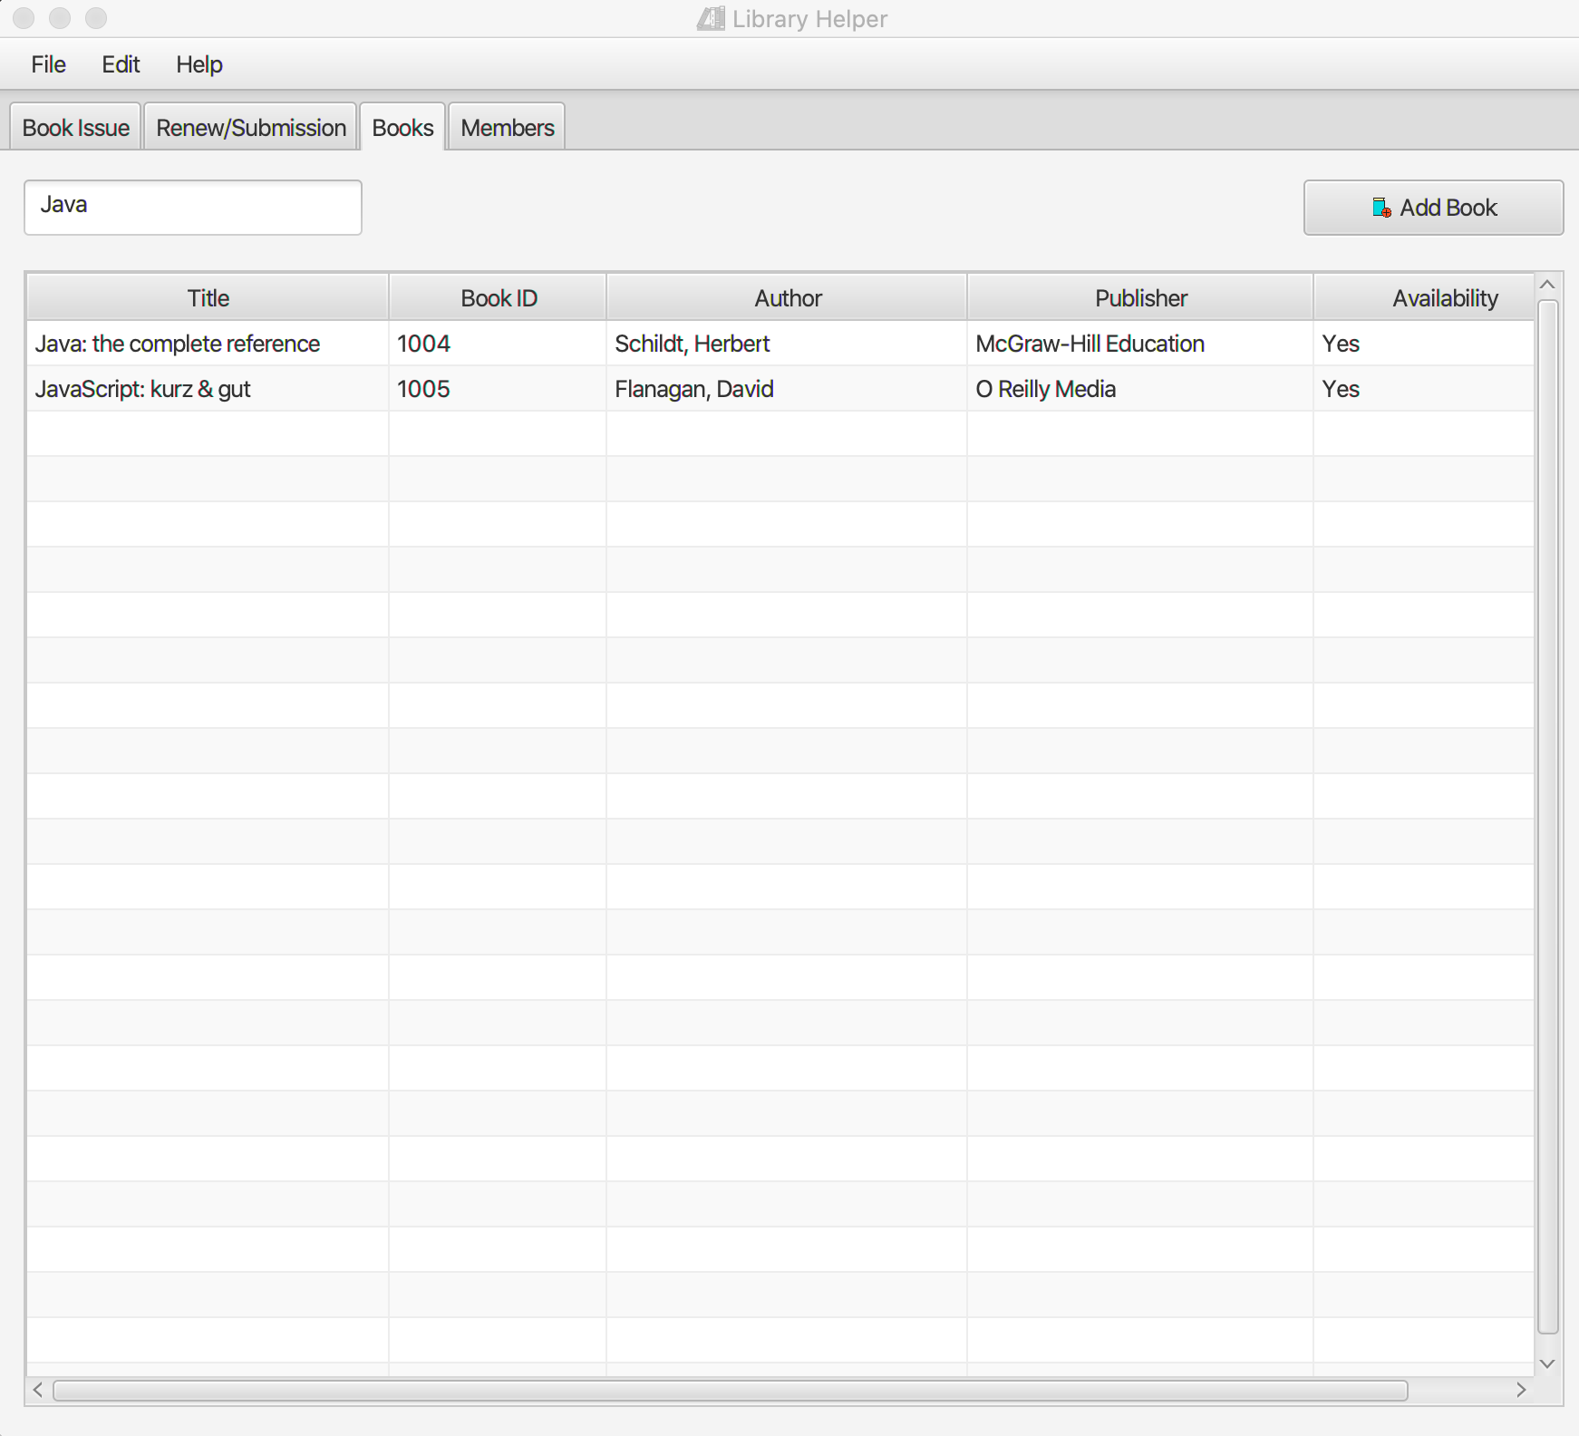
6. Search books
Click on the “Search a book...” text field on the left and type some characters to search by any attributes
For example, typing “Java” will yield two book titles

Slide 18
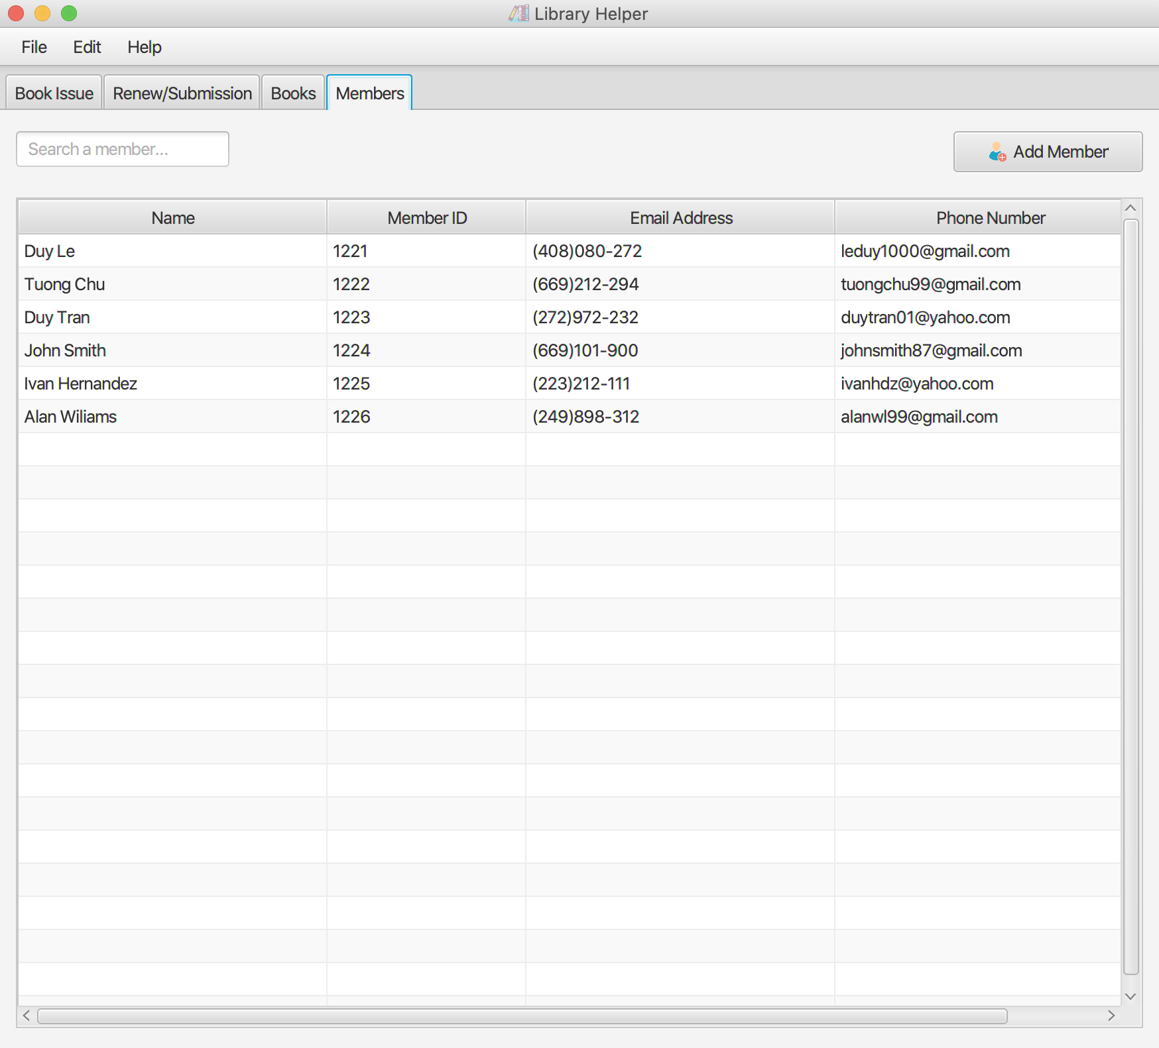
7. View current members
Click on the “Members” tab on the Menu bar
Some member data have been initiated into the database

Slide 19
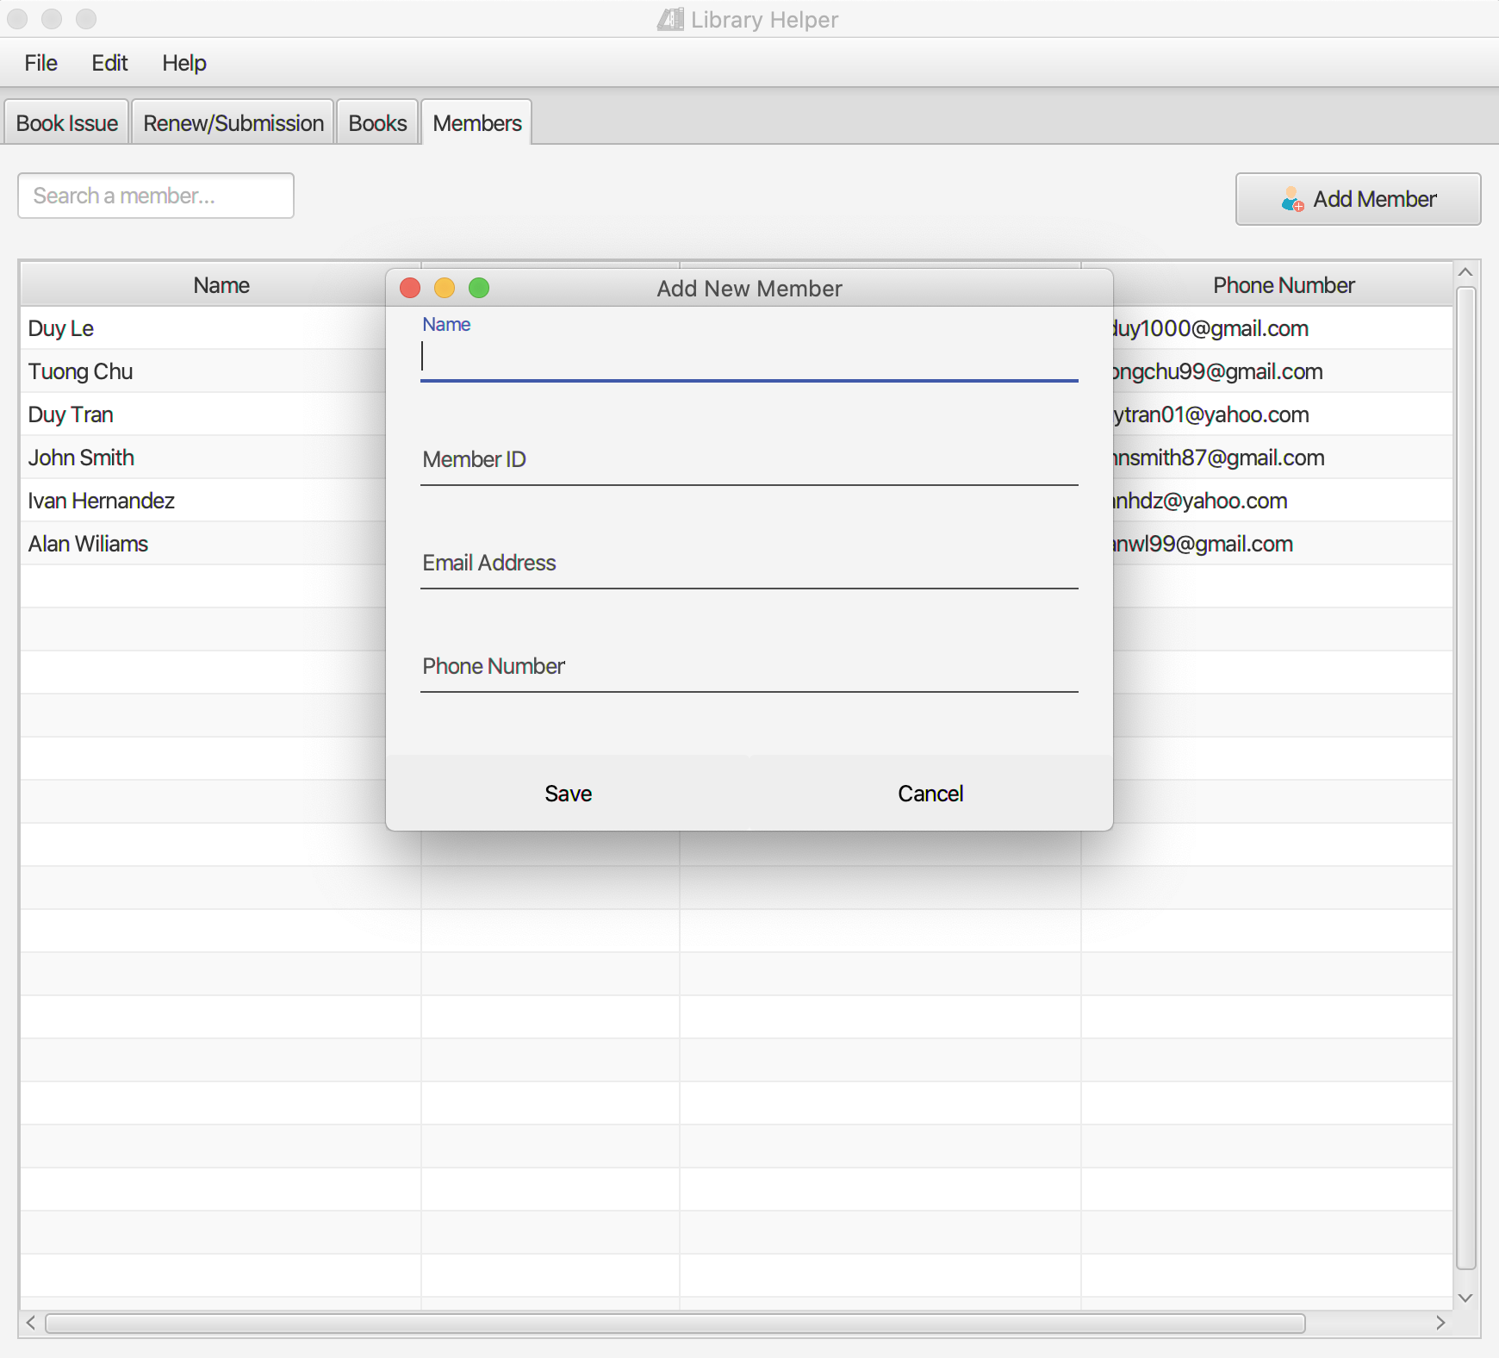
7. Add new members
Click on the “Add Member” button on the right and fill out the form with the new book’s information

Slide 20
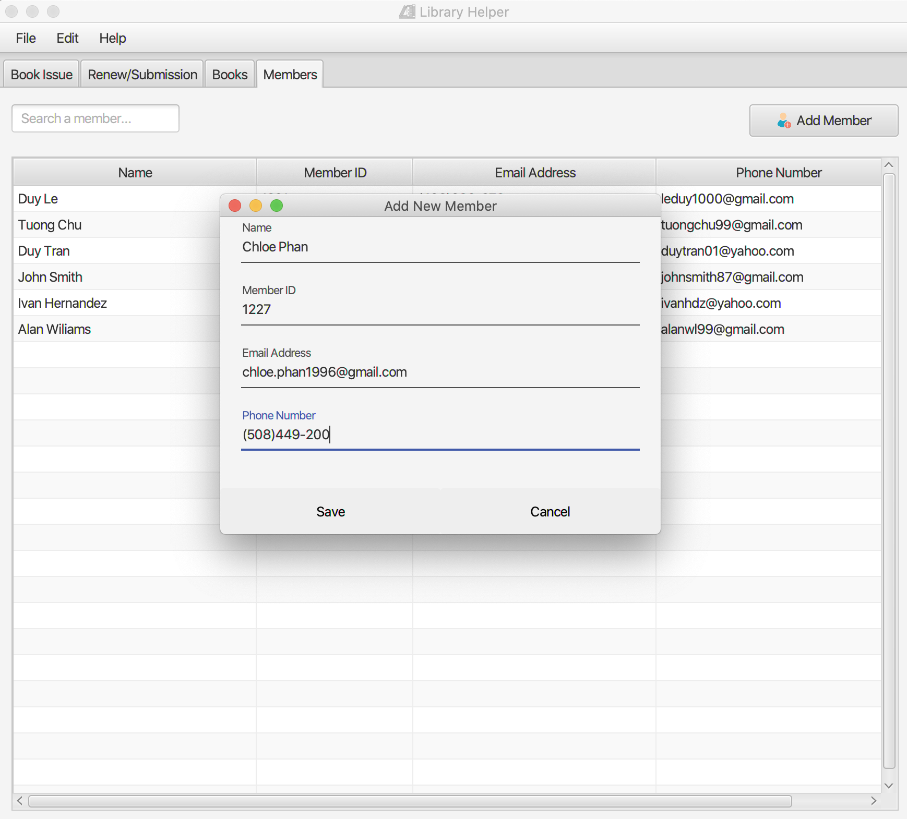
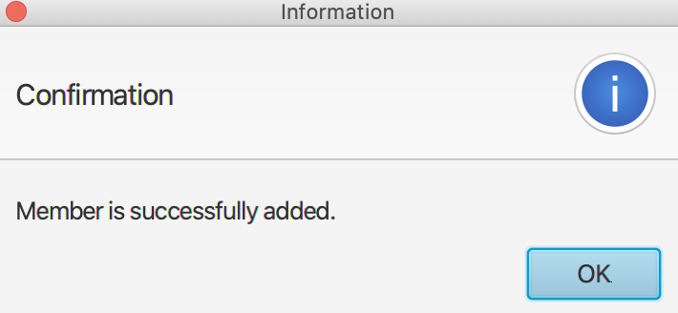
7. Add new members
Click on the “Save” button to add the new member to the database

Slide 21
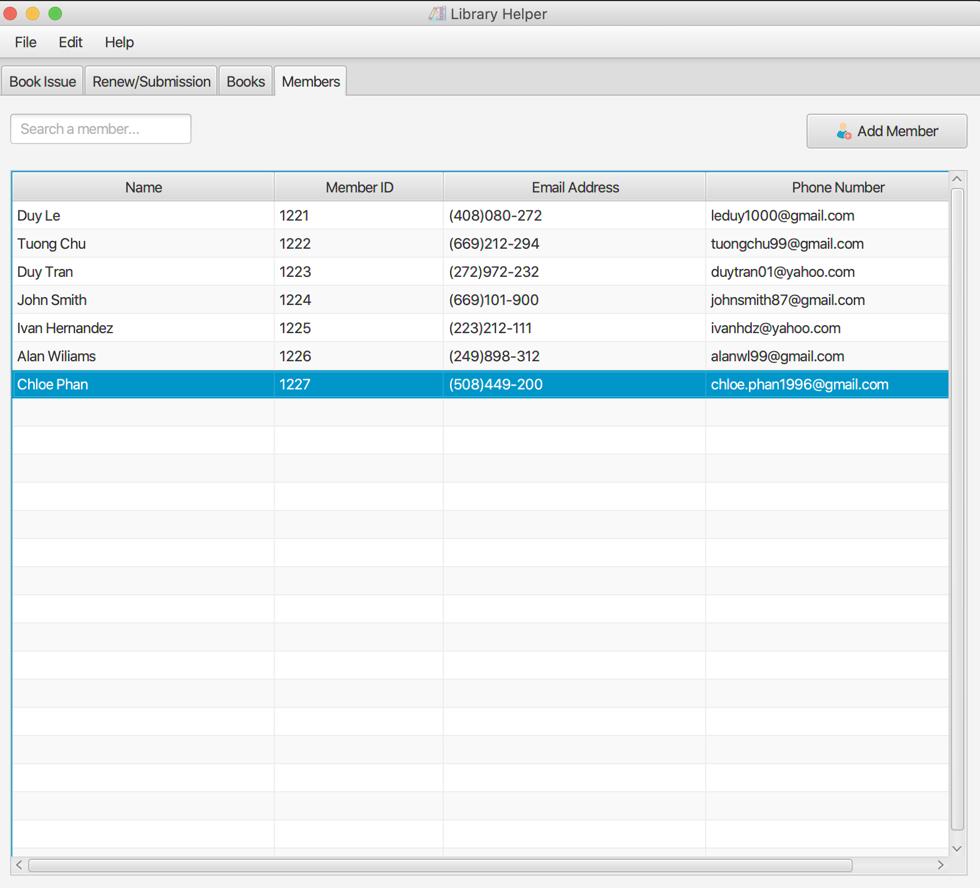
7. Add new members
The new member named “Chloe Phan” was added and displayed on the member list.

Slide 22
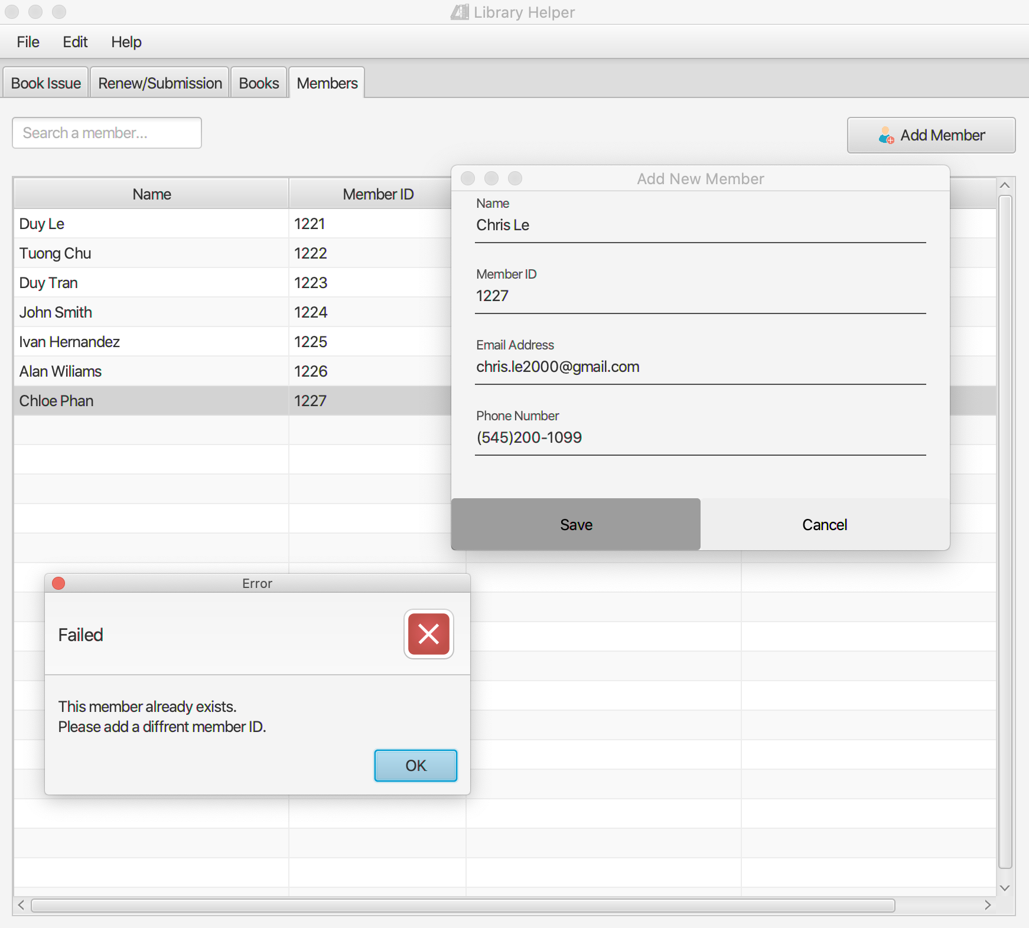
7. Add new members
Member ID is a unique key, so if users type in an existing ID, an error message will be displayed.

Slide 23
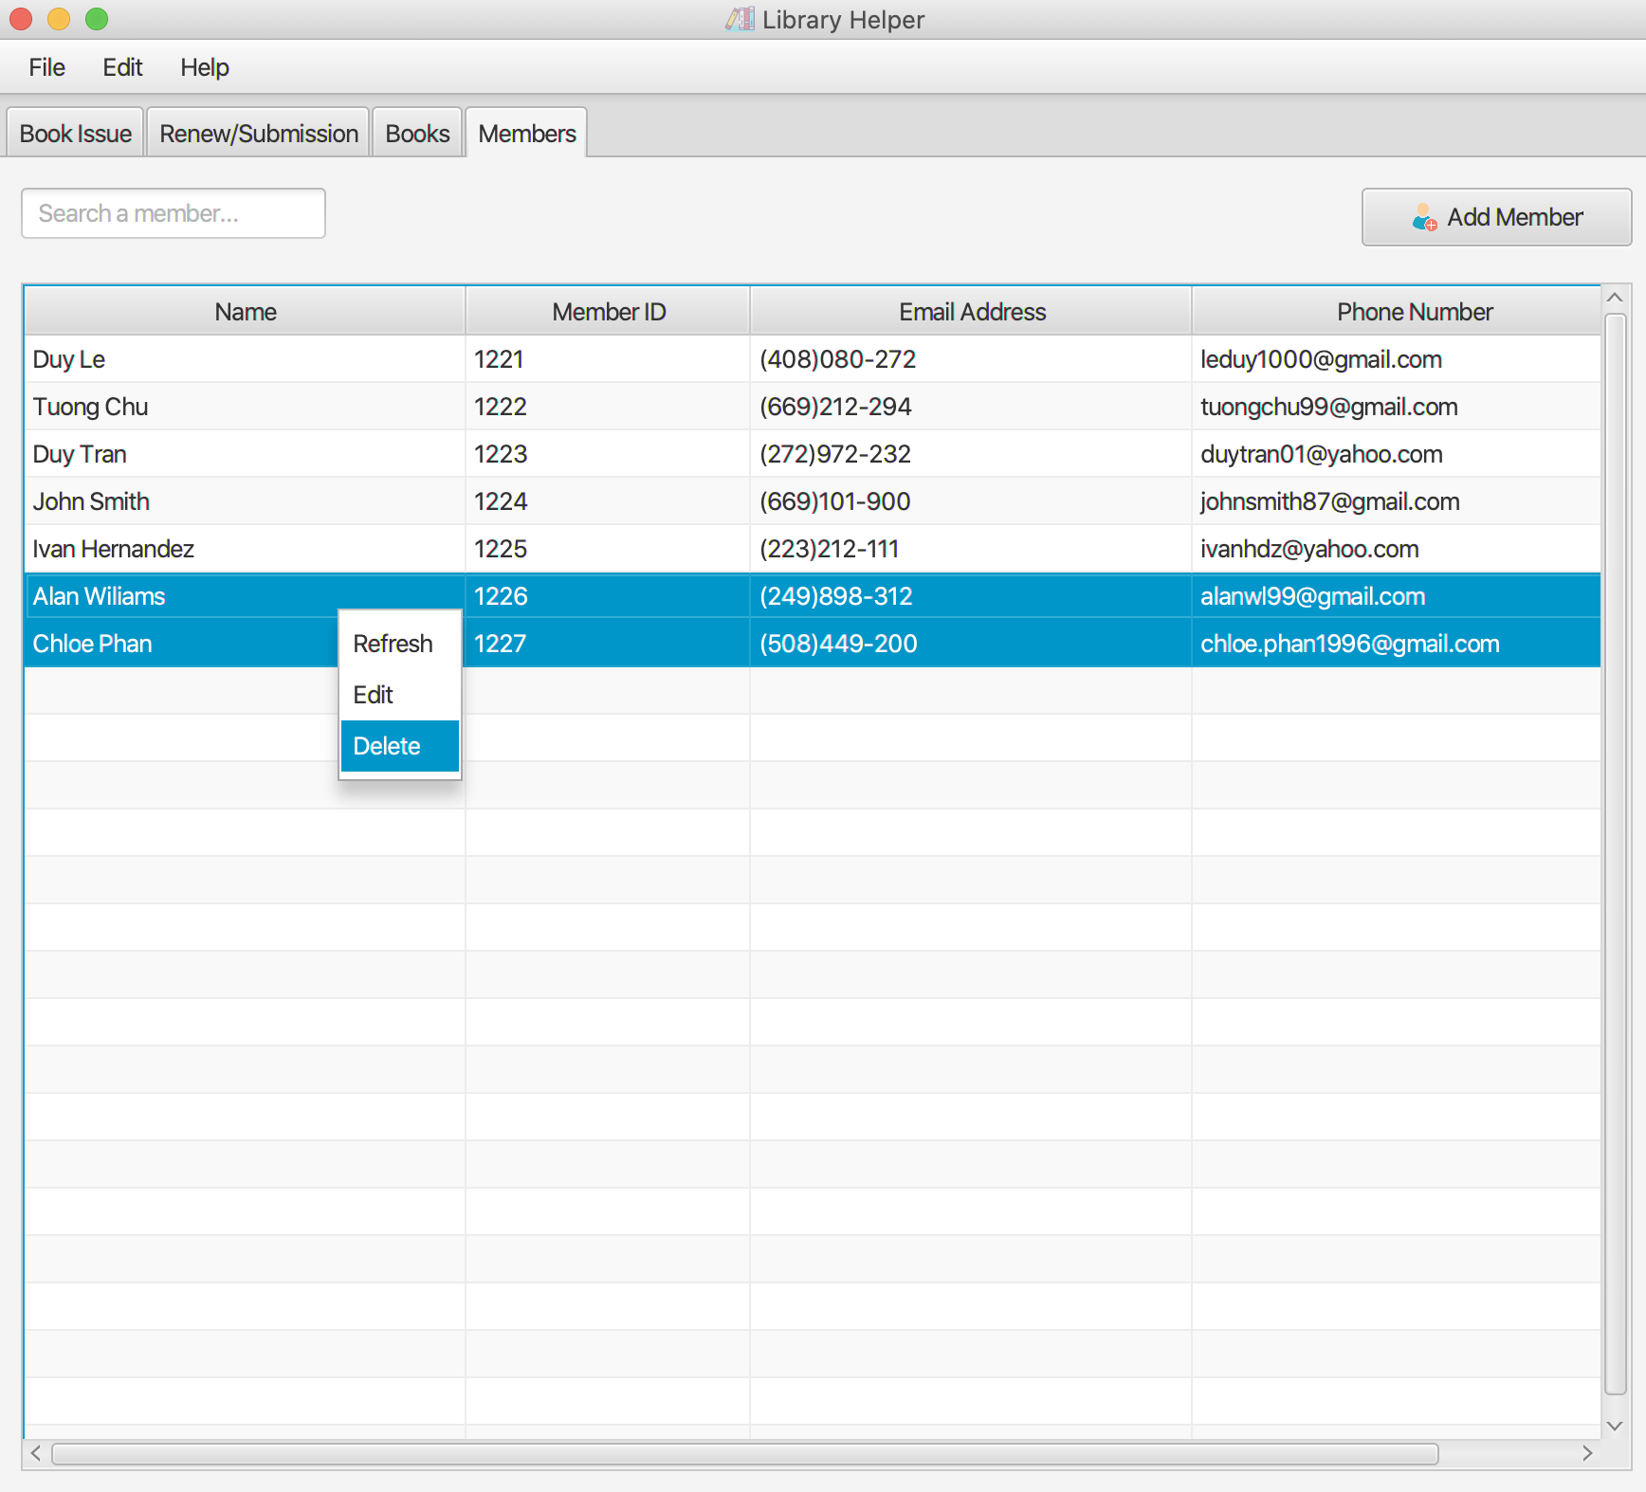
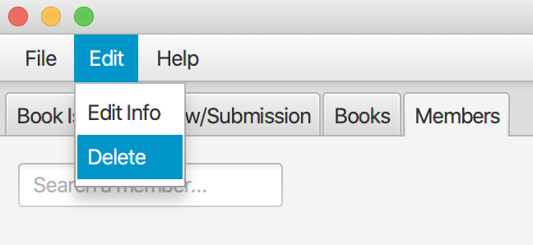
8. Delete members
Click on one or more members to select them.
Then right click and choose “Delete”
Or click on ”Edit” tab on the Menu bar and choose “Delete”

Slide 24
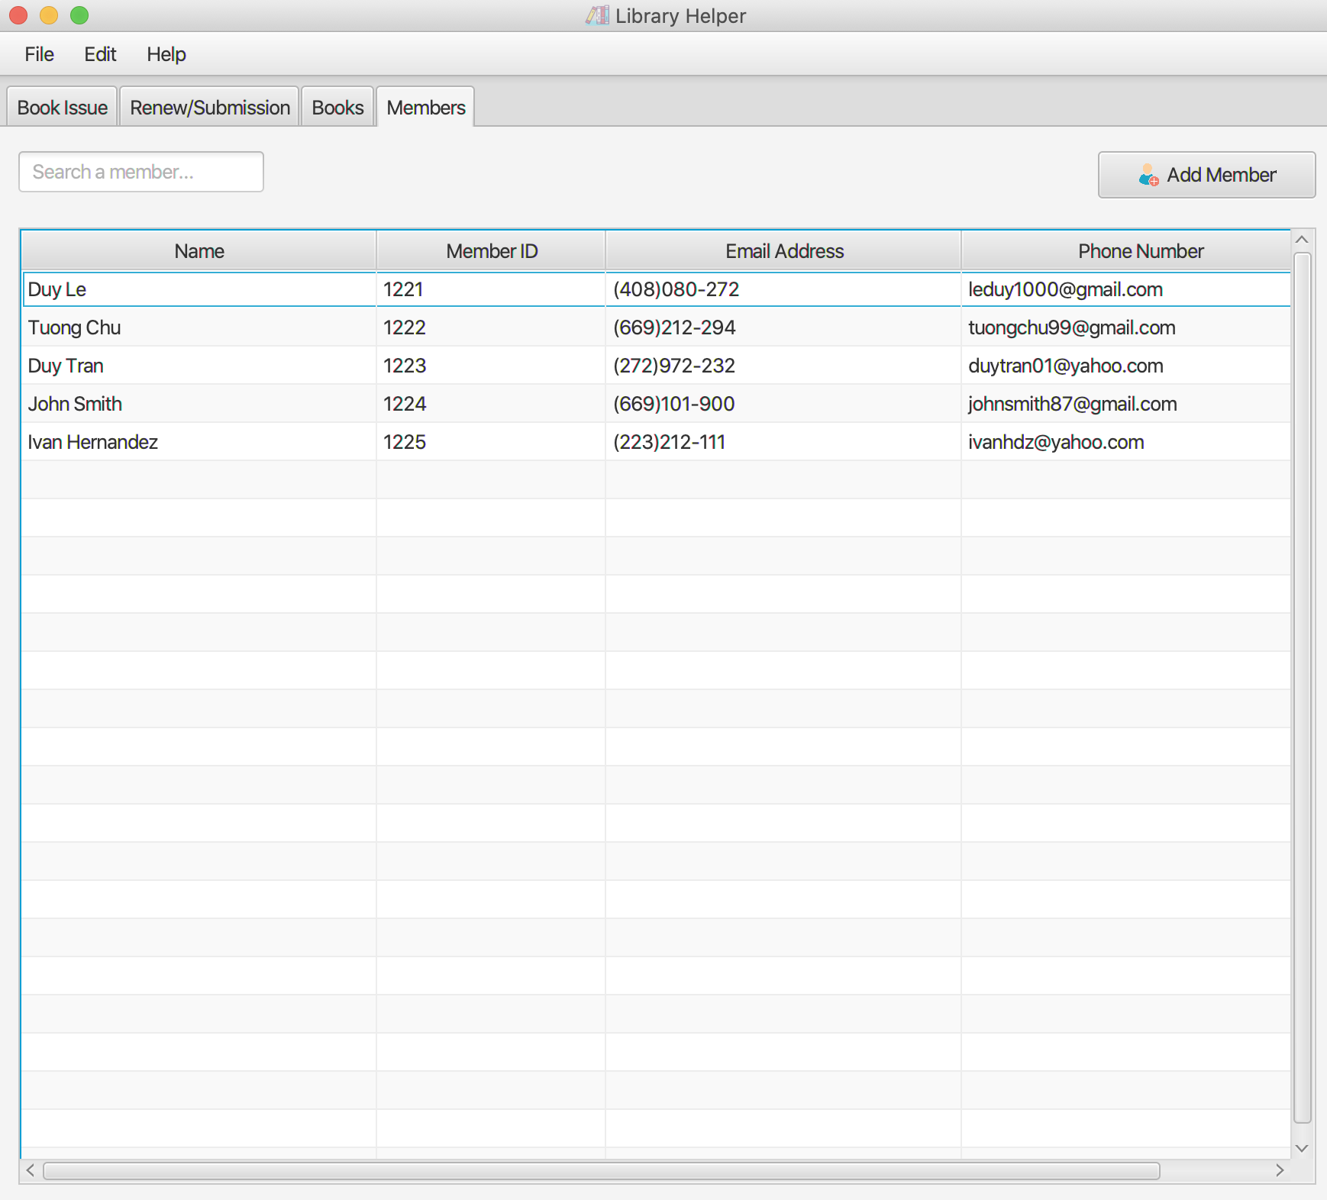
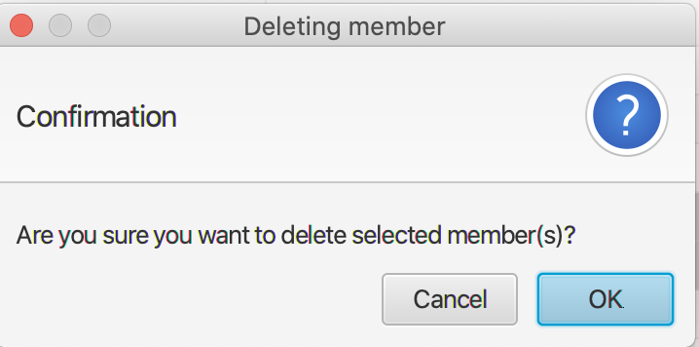
8. Delete members
Click on OK button to delete selected members from the database
Members id “1226” and “1227” have been removed from the list

Slide 25
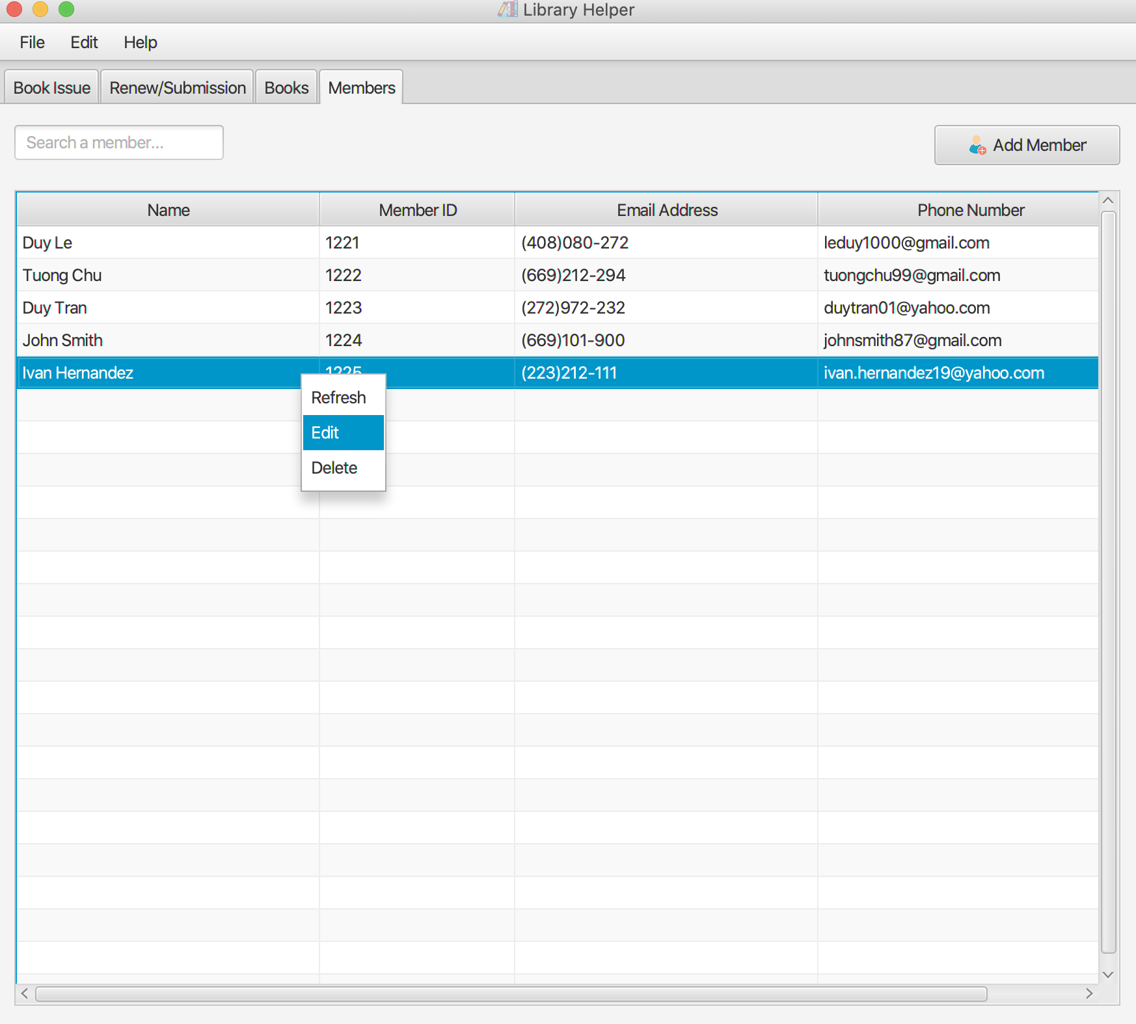
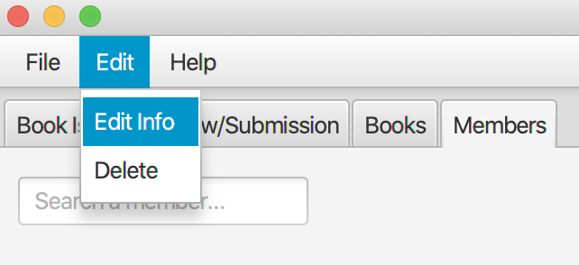
9. Edit members
Click on a book to select
Right click and choose Edit to edit its information
Or click on ”Edit” tab on the Menu bar and choose “Edit Info”
Member ID cannot be edited

Slide 26
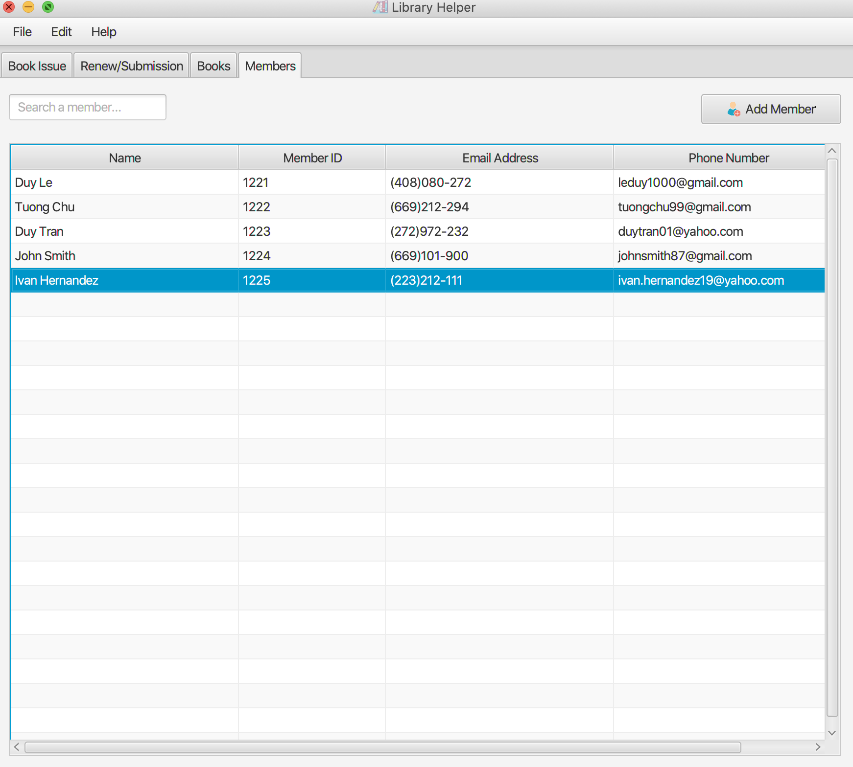
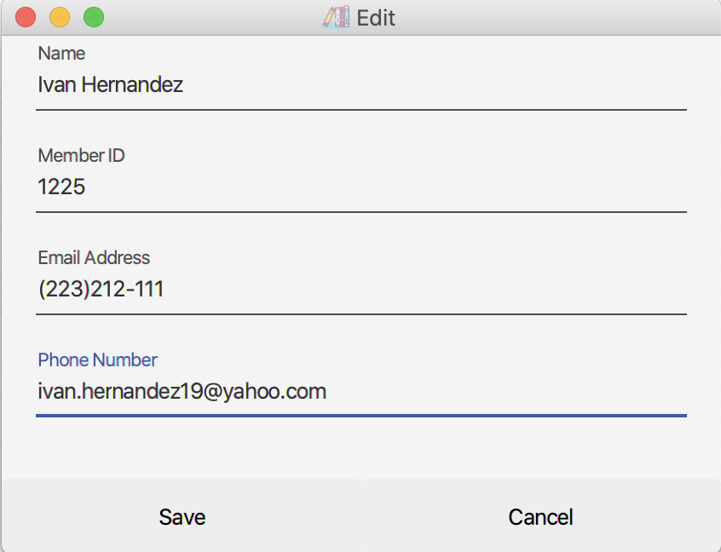
9. Edit members
Click on a book to select
Right click and choose Edit to edit its information
Or click on ”Edit” tab on the Menu bar and choose “Edit Info”
Member ID cannot be edited

Slide 27
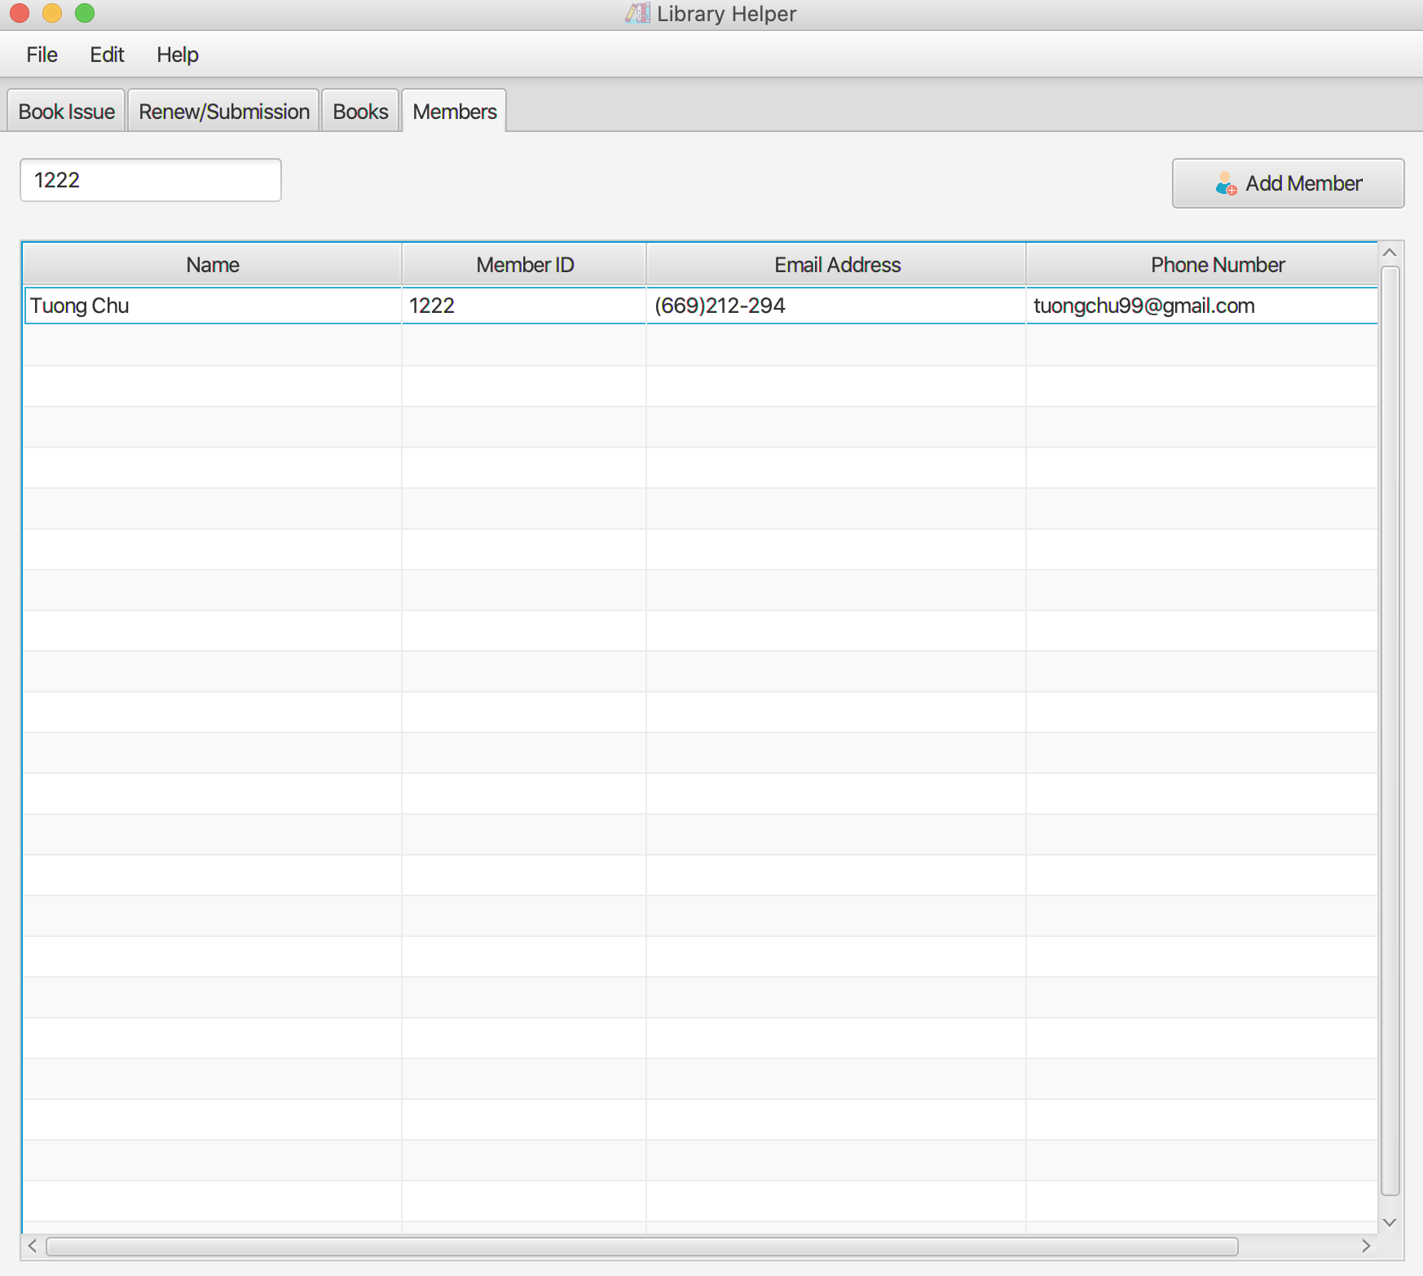
10. Search members
Click on the “Search a member...” text field on the left and type some characters to search by any attributes
For example, typing “1222” will yield member info with id 1222

Slide 28
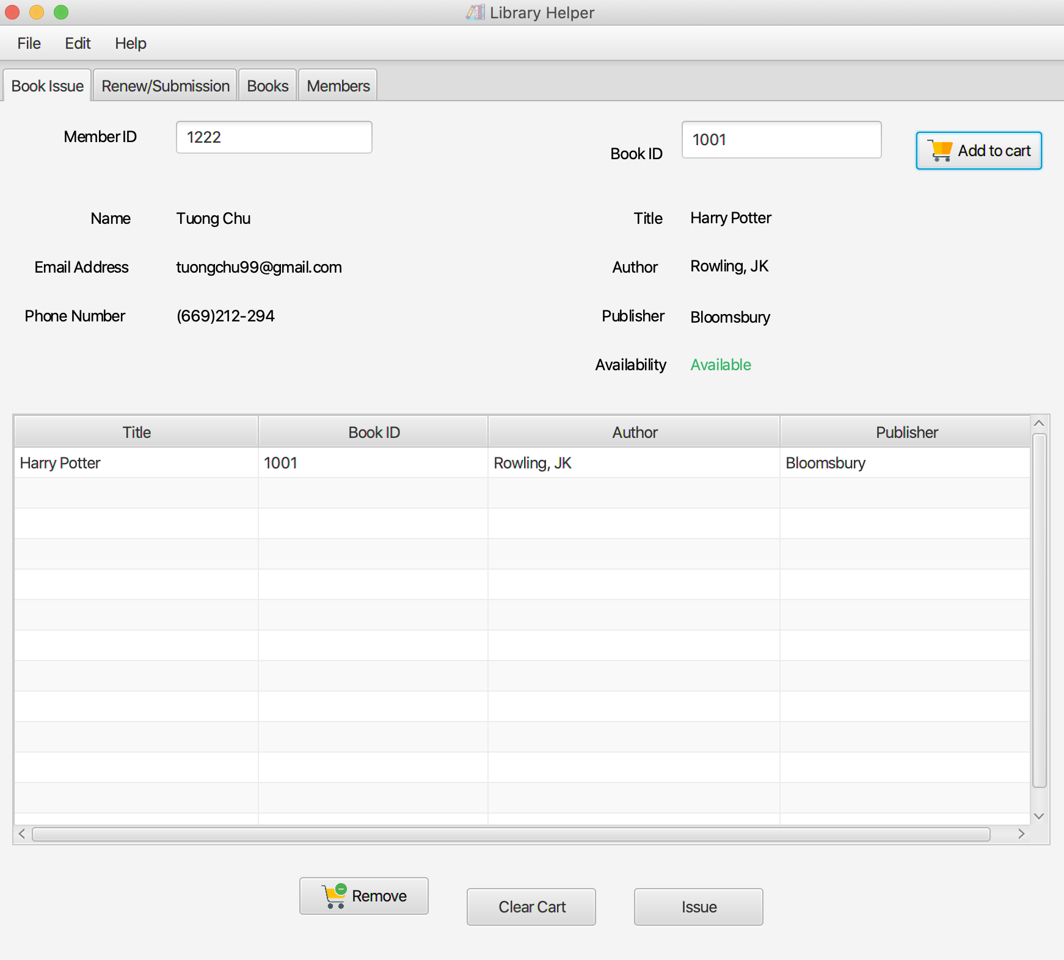
11. Issue Books
Type a member ID and a book ID on the text fields on the top to retrieve their information.
Then click “Add to cart” button on the right to add a book to cart.

Slide 29
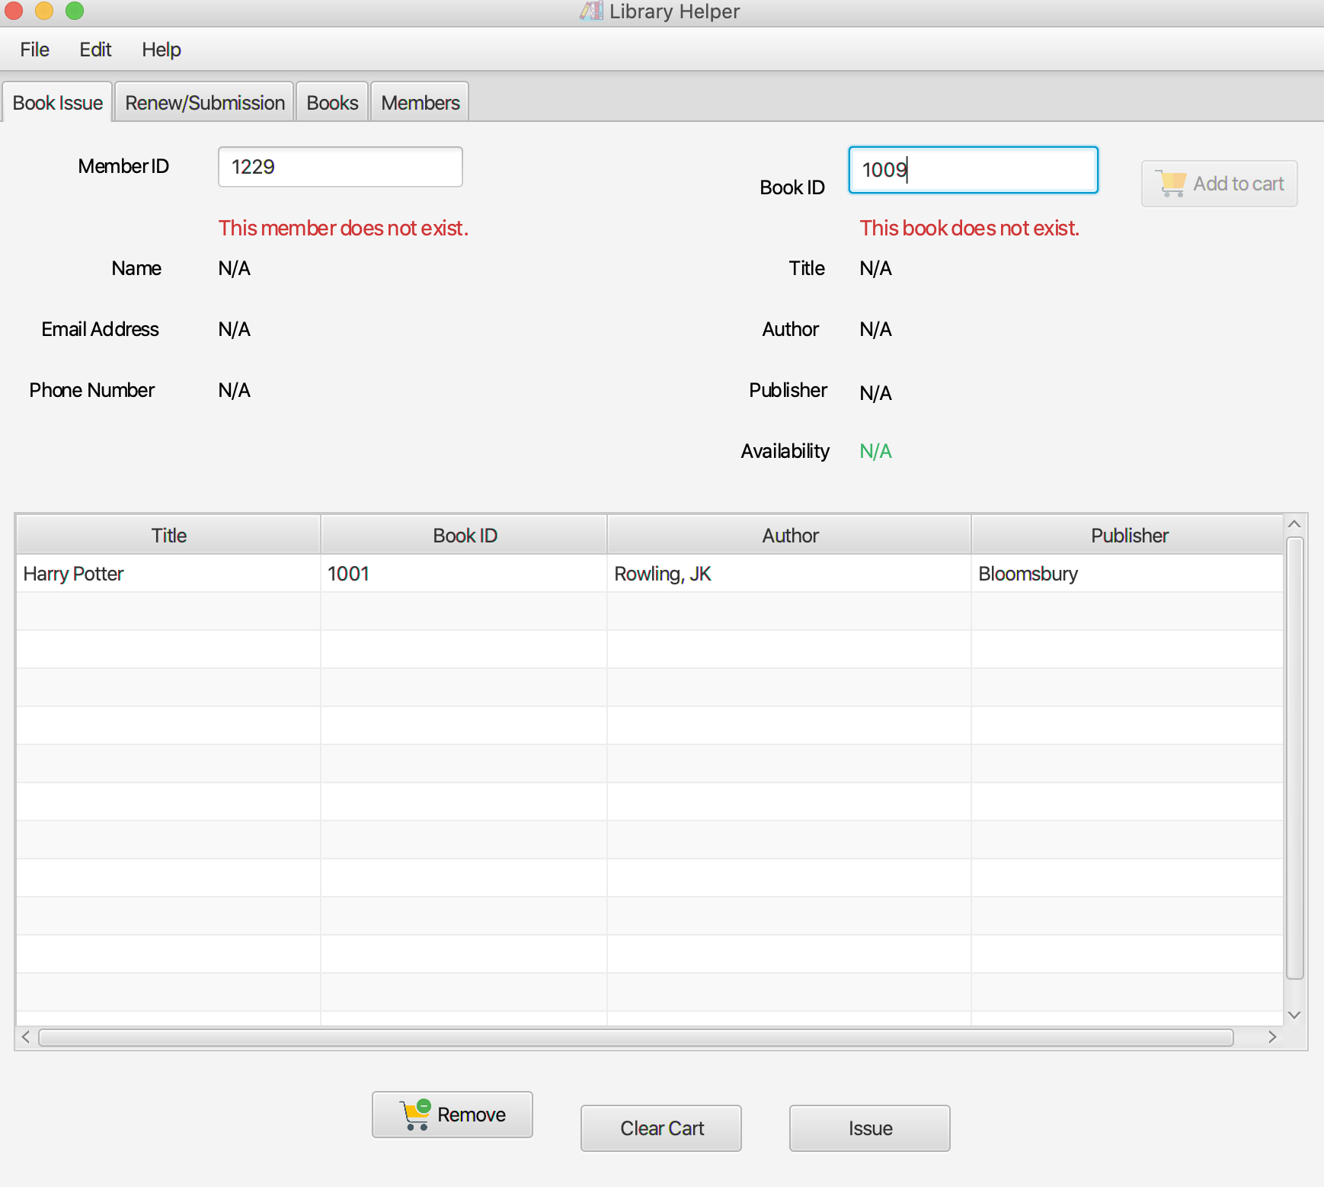
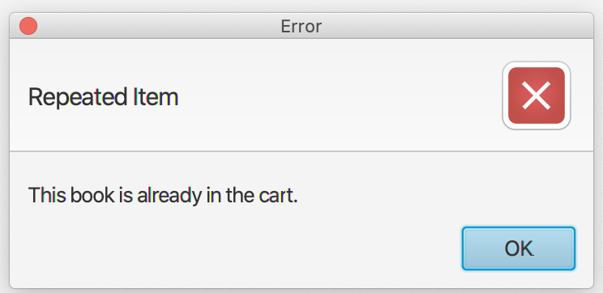
11. Issue Books
Input of Member and Book ID that don’t exist in the database; or adding the same books in the cart will yield an error message.

Slide 30
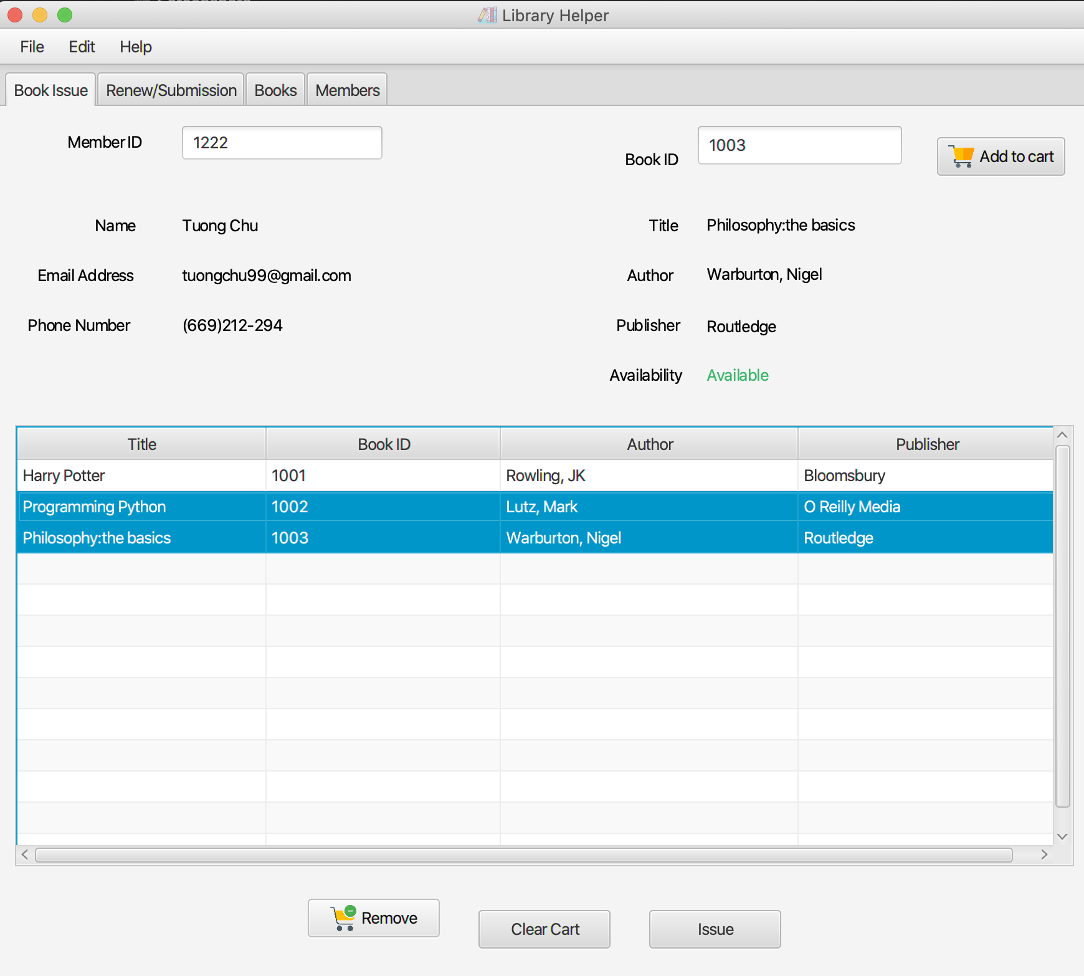
11. Issue Books
Users can add multiple books to the cart

Slide 31
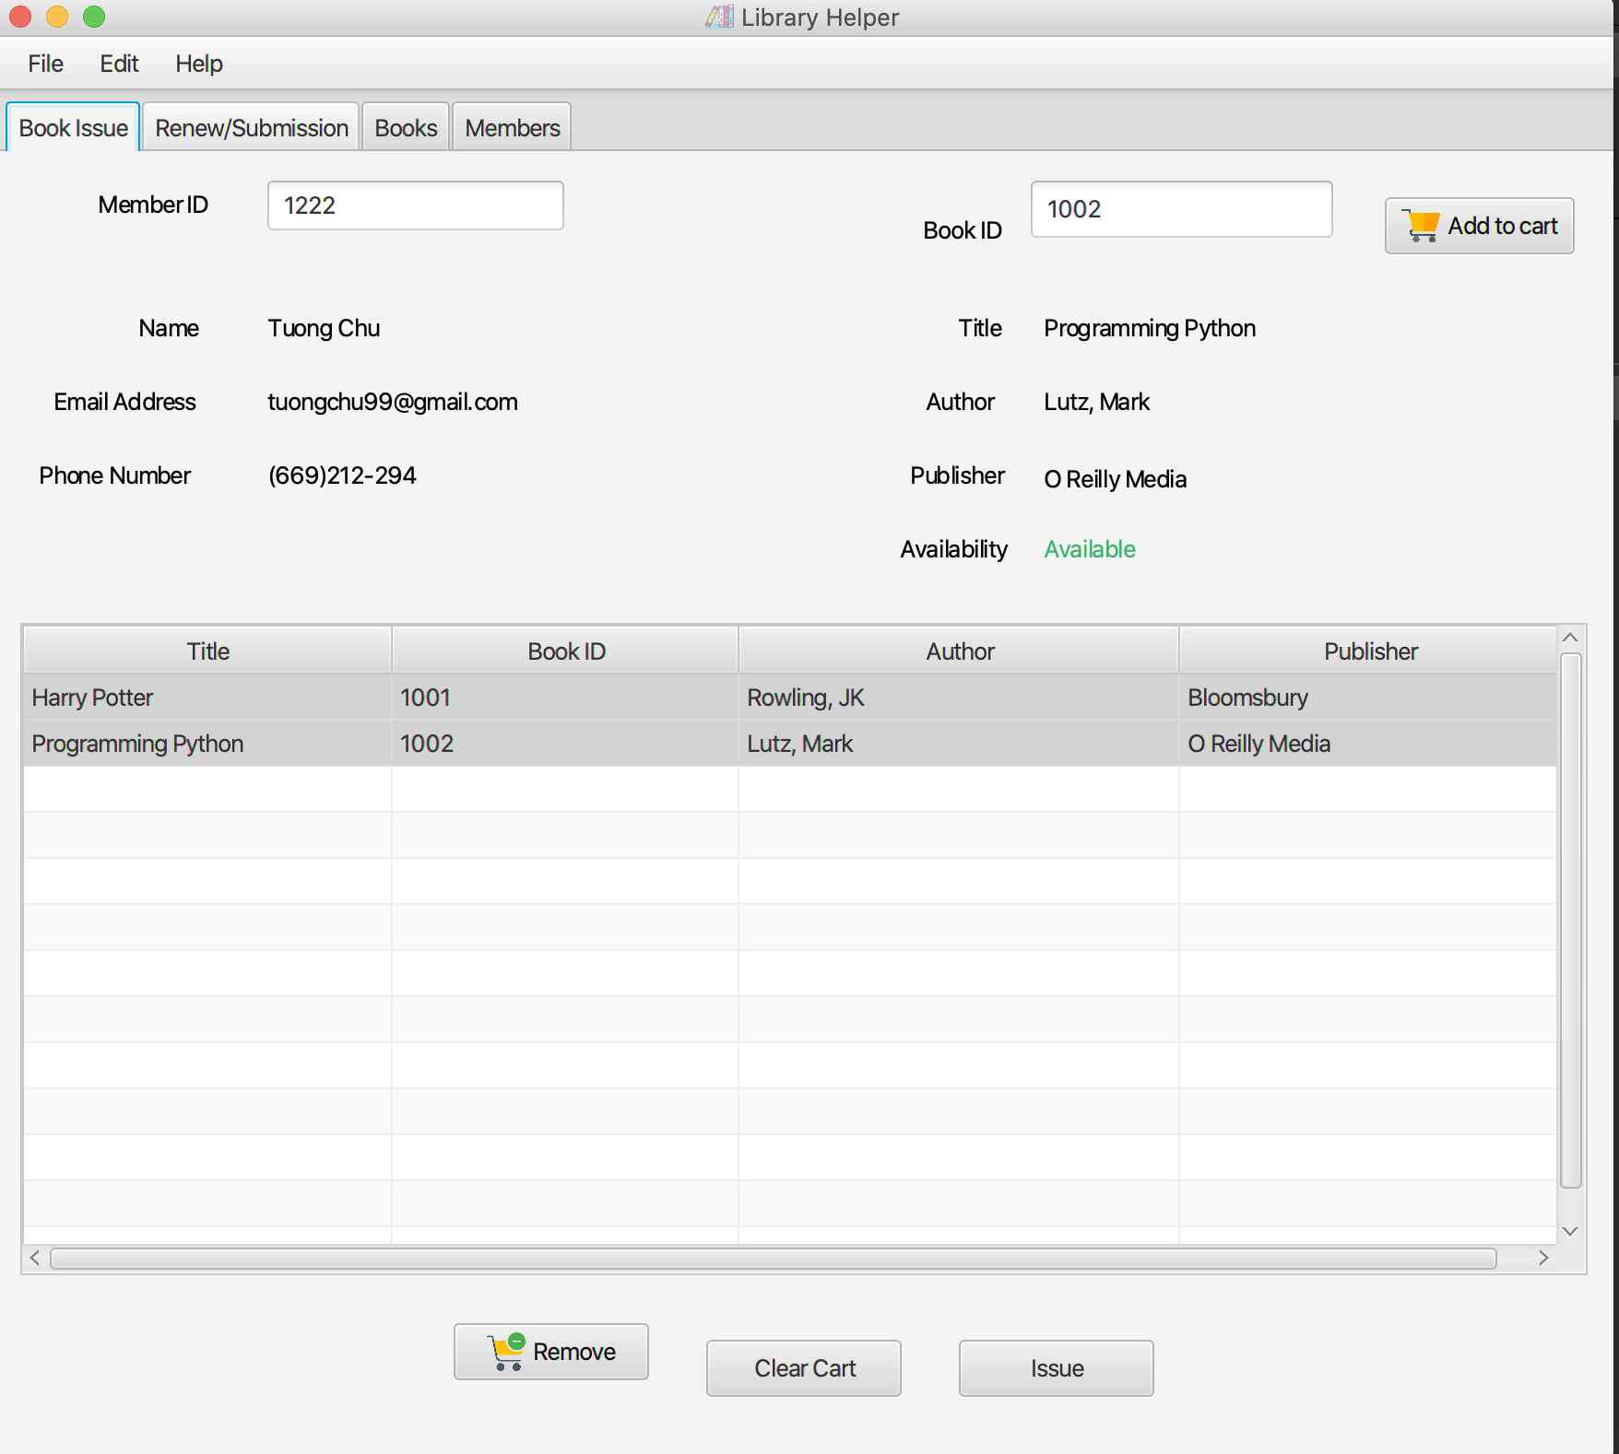
11. Issue Books
Users can remove multiple books off the cart by selecting them and clicking on the “Remove” button on the bottom.
Users can also clear the cart by clicking on “Clear cart” button

Slide 32
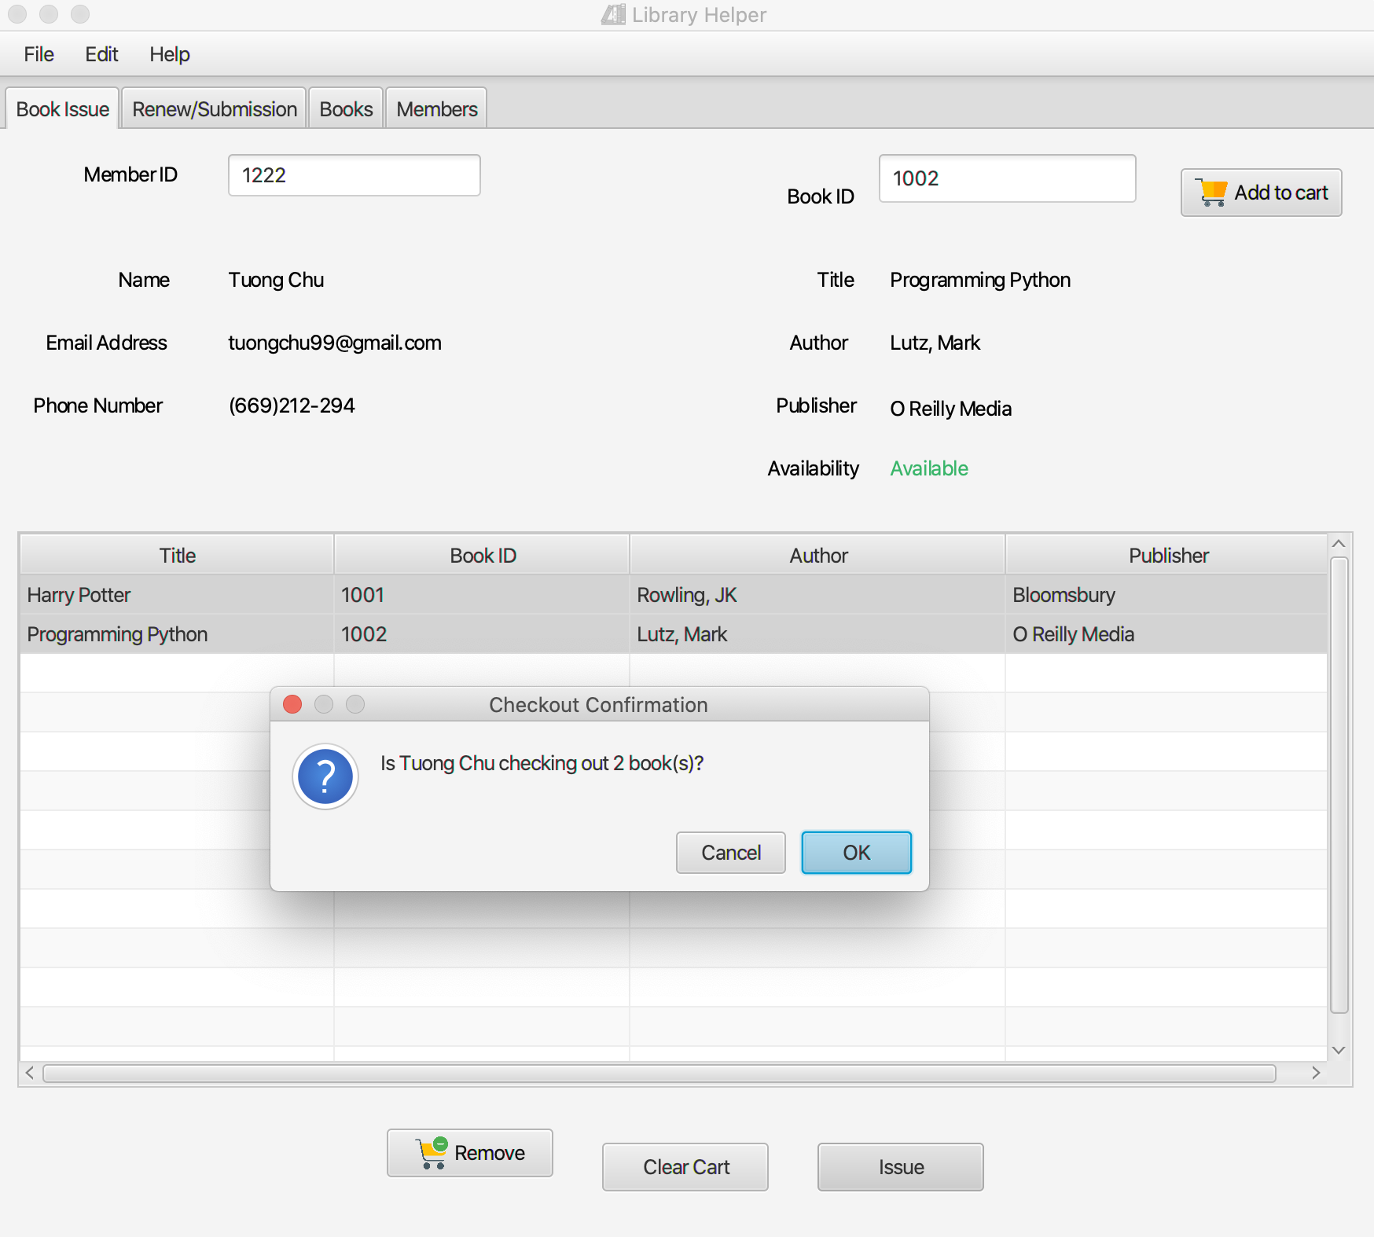
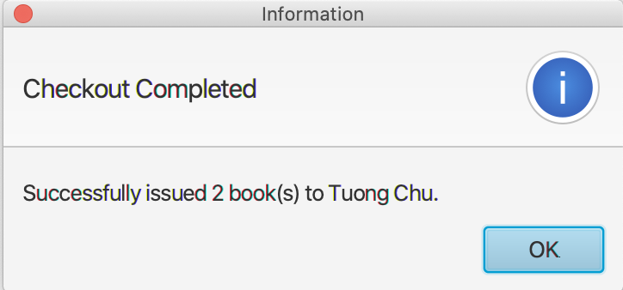
11. Issue Books
Users can issue selected books by clicking on the “Issue button”.
A confirmation message will pop up.

Slide 33
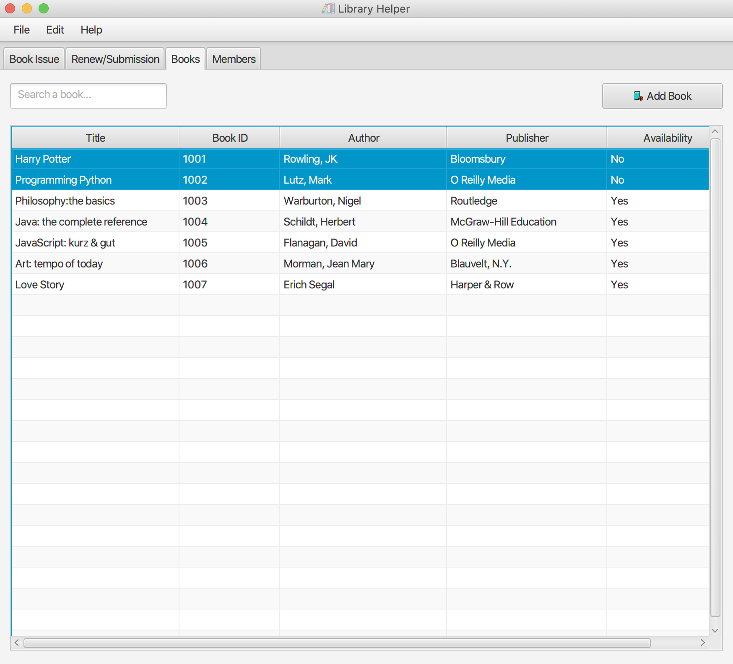
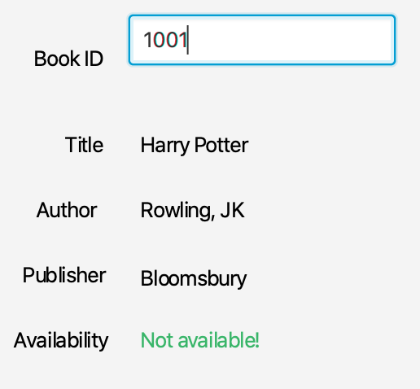
11. Issue Books
After being issued, Books’ availability will be changed to NO at the Books and Book Issue pages

Slide 34
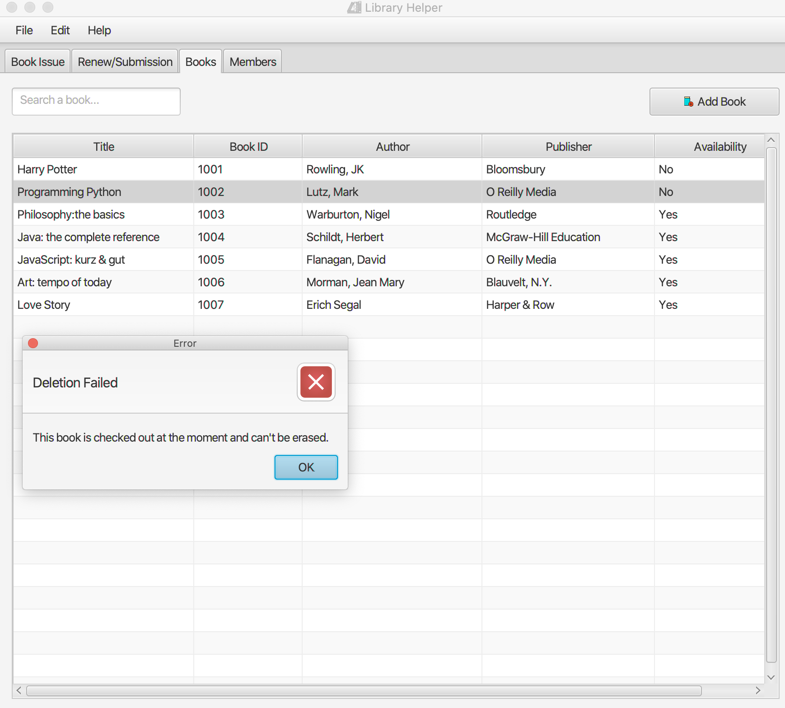
11. Issue Books
Now, deleting book that’s being unavailable will yield an error message

Slide 35
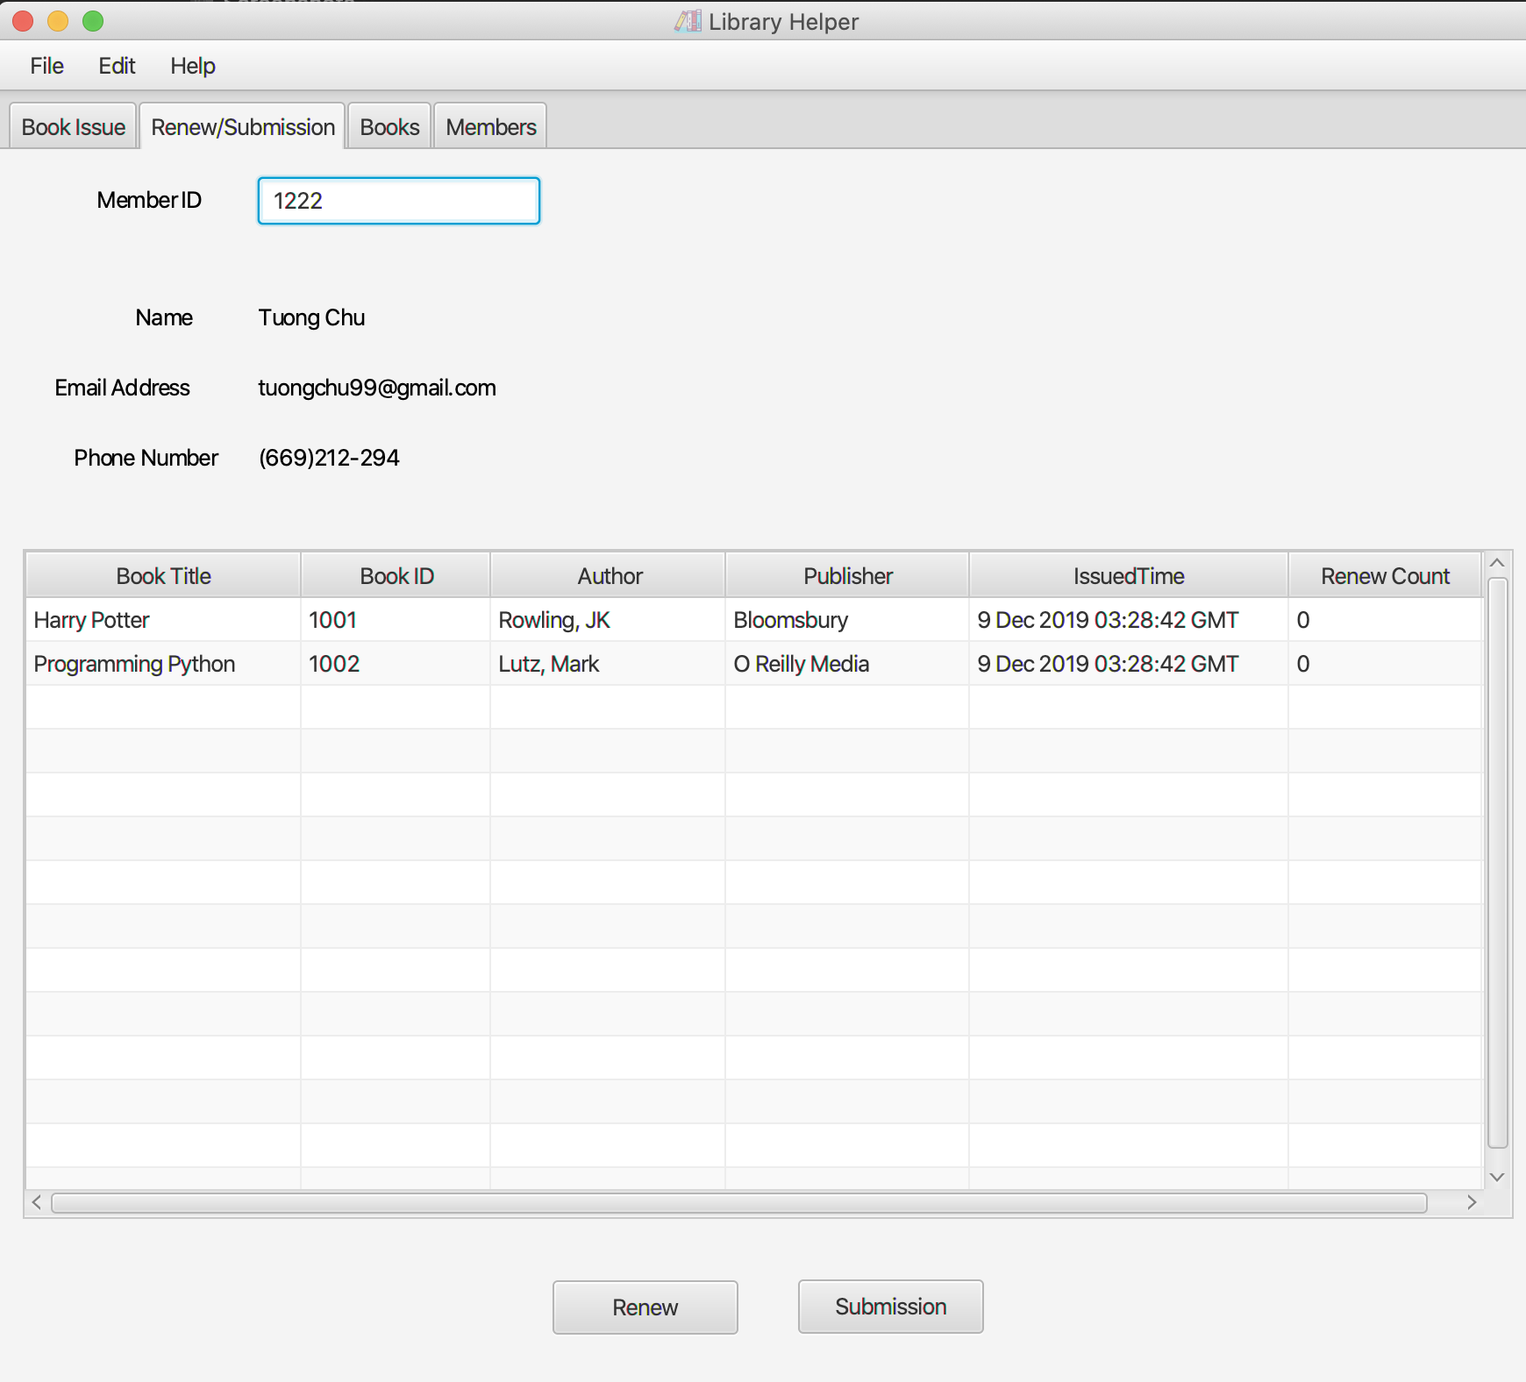
12. Renew Books
To check which books a member is borrowing, go to the tab “Renew/ Submission” type in the member ID.

Slide 36
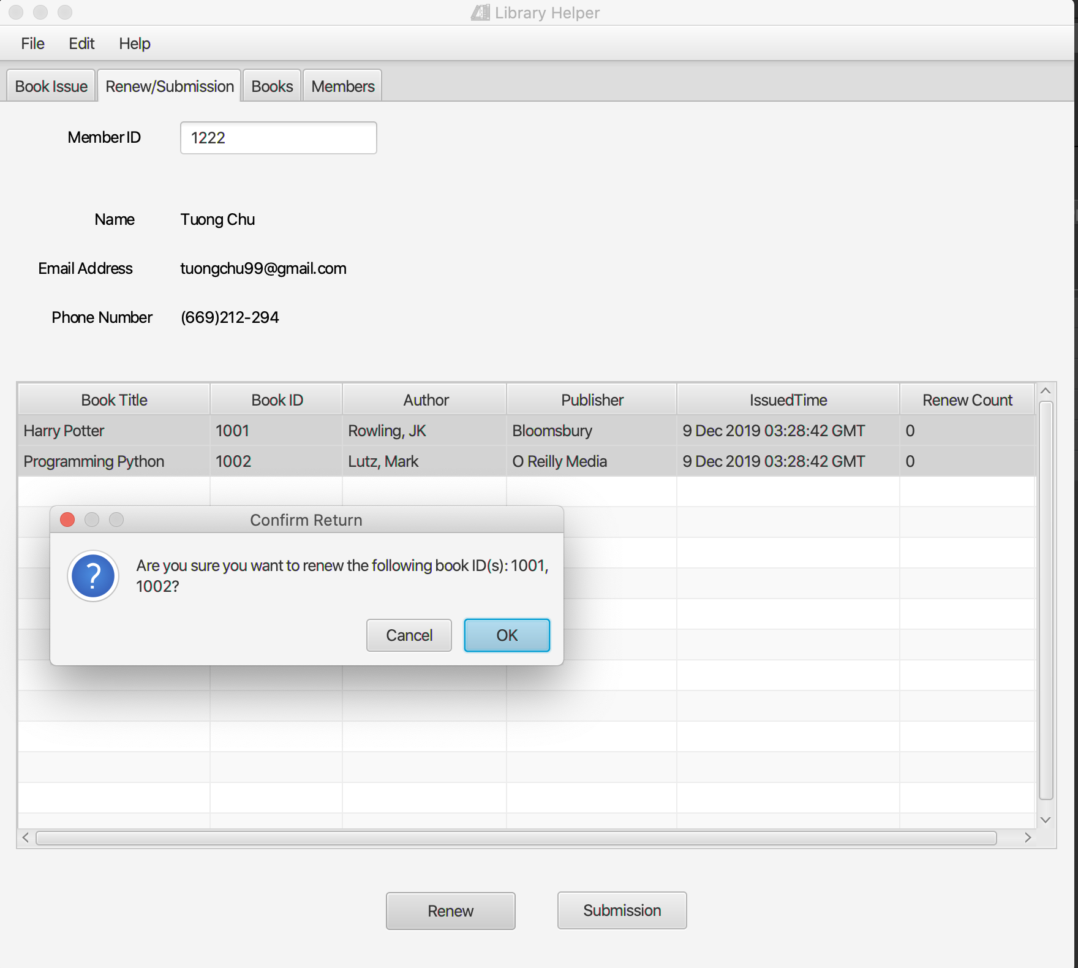
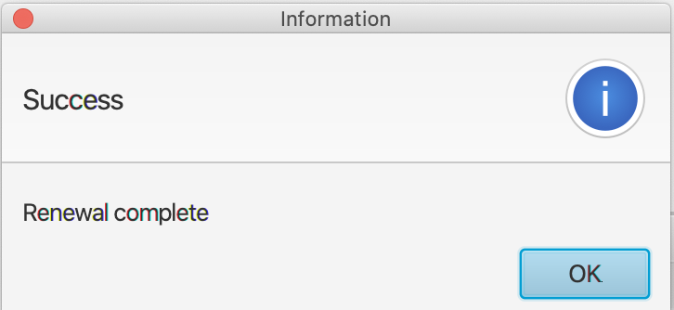
11. Renew books
To renew books for a member, select them and click on the ”Renew” button at the bottom.
A confirmation message will pop up.

Slide 37
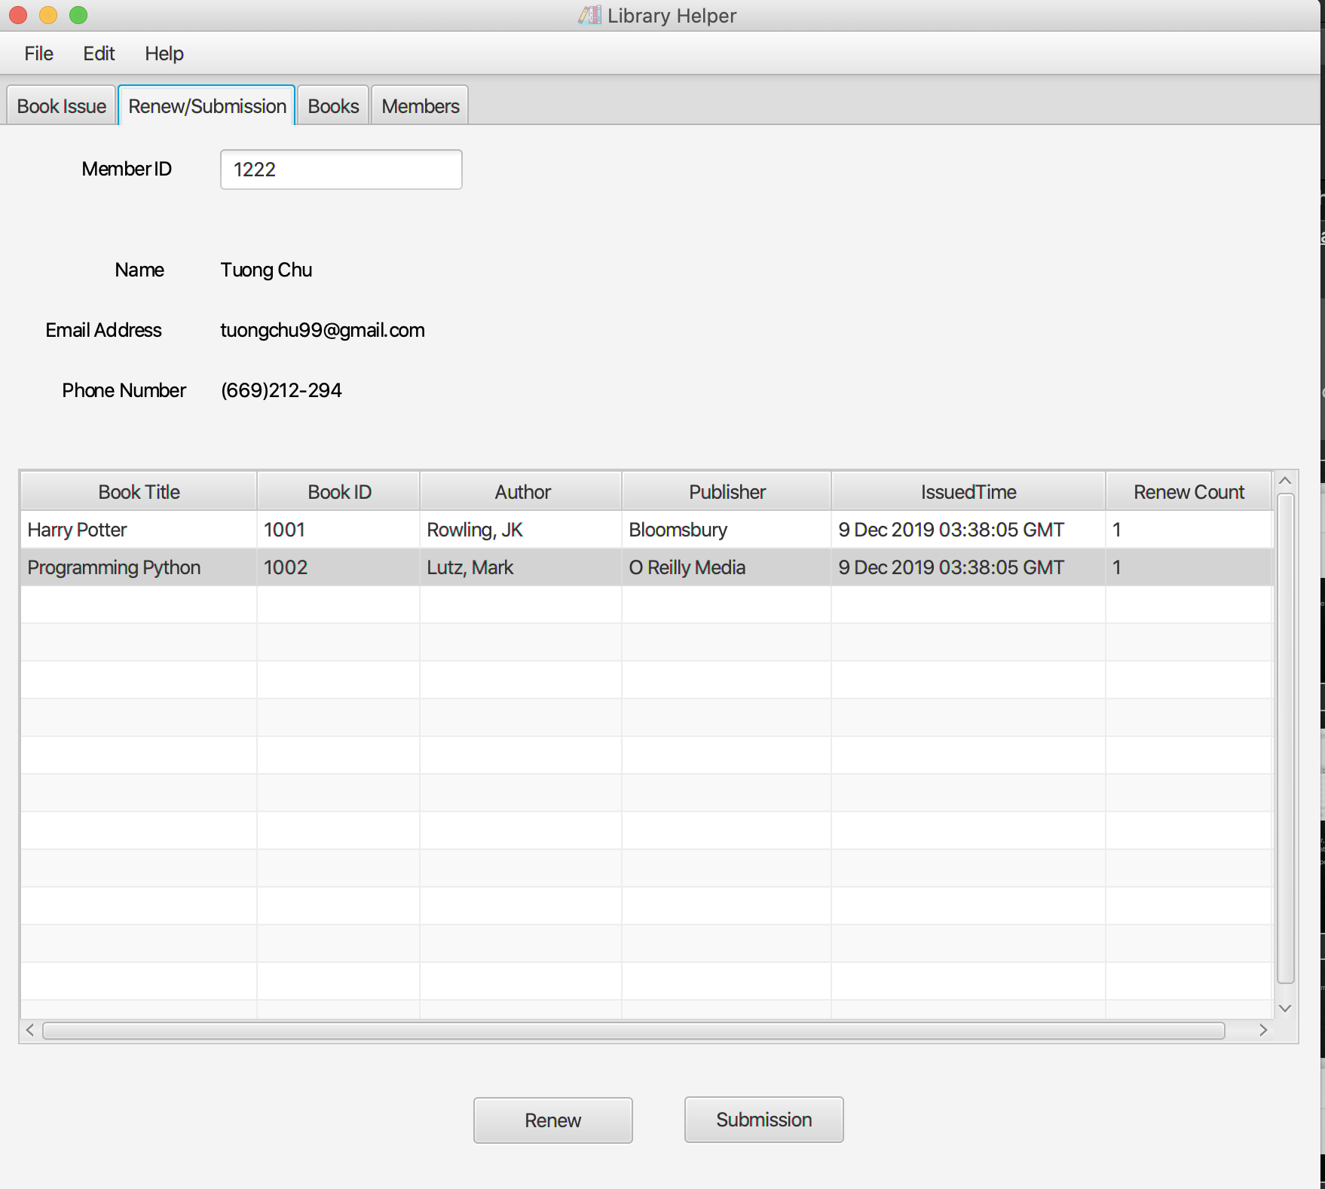
11. Renew books
After renewal, Books’ IssueTime was changed to the current time, and the Renew Count is incremented to 1.

Slide 38

12. Submit books
To submit books back to the library, select them and click on the “Submission” button at the bottom.
A confirmation message will pop up

Slide 39


12. Submit books
Books that were submitted will be removed from the table.

Slide 40


12. Submit books
Books that were submitted will also have their availability switched to Yes in the Books and Book Issue pages.

Slide 41


13. Settings
Users can change the app’s settings by clicking File>Settings
A window will pop up.

Slide 42


13. Settings
Users can edit borrowing period without fine, fine per day, username and password, then click save to submit.
Password will be saved as hash codes for security.

Slide 43

13. Settings
Now, an updated username and password will be required to login to the app,

Slide 44
The End Thank You

